Slide 1
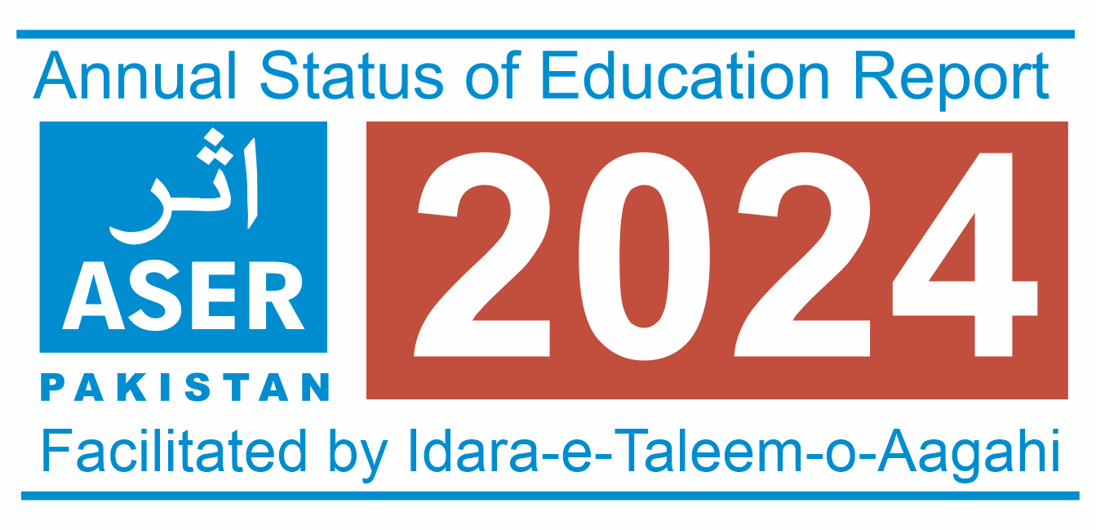


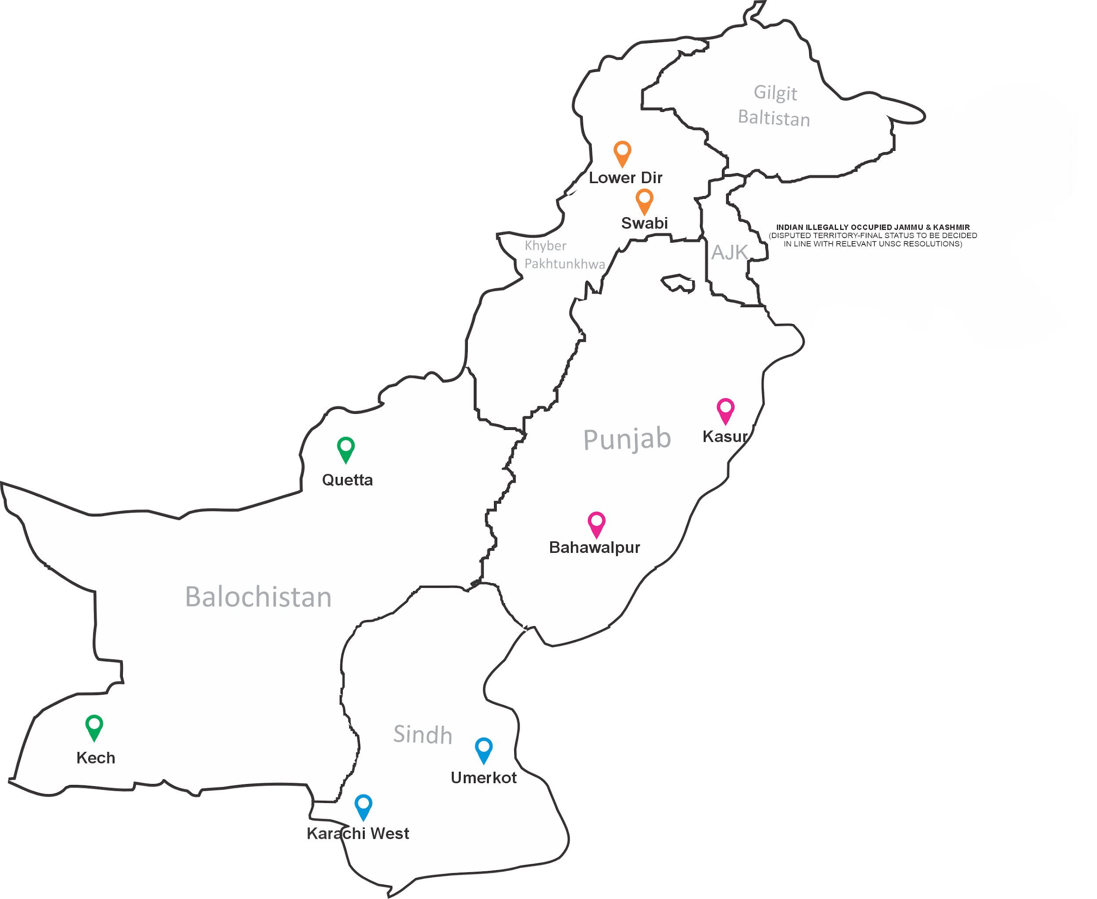


Slide 2



ASER SURVEYS 2008-2024
Disability inclusive
Disability inclusive
Disability inclusive
Disability inclusive
Districts
Children
11
16737
85
143826
138
249832
167
273378
175
273657
174
287570
16
25448
171
272370
ASER National
Learning
Losses
2008
2011
2013
2015
2018
2021
2023
2010
2012
2014
2016
2019
2022
2024
ASER National
Political Constituencies
Katchi Abadis
CONSTITUENCY BASED
EDUCATION MAPPING
Political Constituencies
Districts
Children
32
54062
136
244477
144
251694
4
144
255269
175
286293
37
2622
4
7293
8
19651
Disability inclusive
Disability inclusive
Disability inclusive
Disability inclusive
Disability inclusive

Slide 3
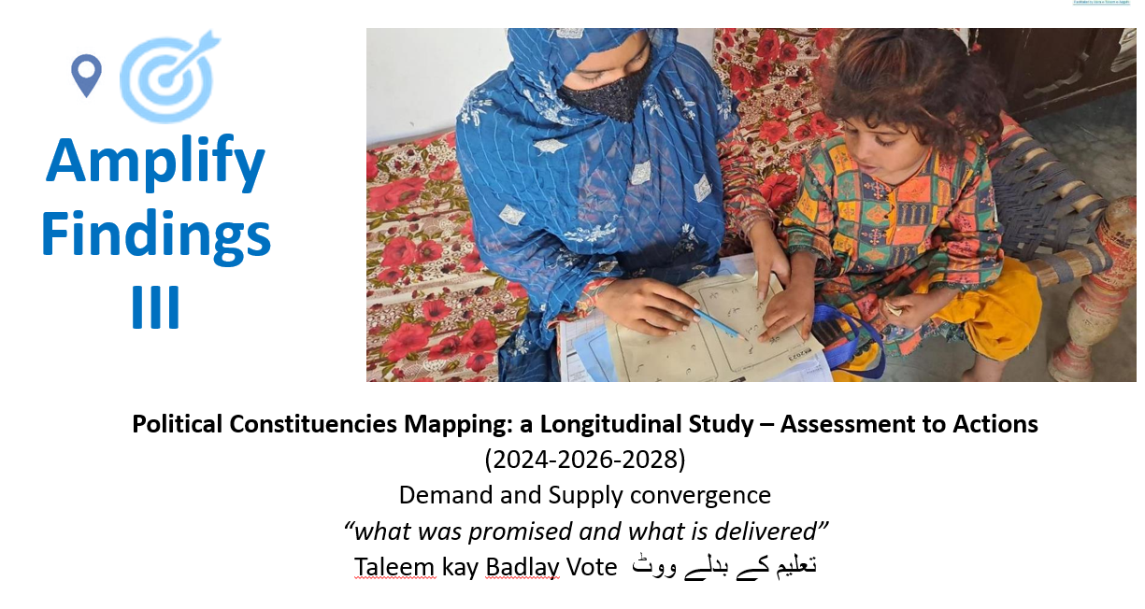
Why Politics Matter: Understanding Power to Reform Education
Political Settlements & Power Dynamics
Examines how elite interests and power structures shape governance and reform potential.
Education Decision-Making is Driven by:
Bureaucracies – Provide technical data, institutional memory, and continuity.
Politicians – Influence reforms and resource allocation to serve constituency interests.
Political Incentives & Priorities
In a competitive political environment, visible actions (e.g., building schools, classrooms, auditorium, computer labs) are prioritized to gain support.
Focus often comes at the expense of learning outcomes & education quality.
Does Education matter to Politicians?

Slide 4
Introduction and Objectives
About the Study: ASER survey across Political Constituencies
Launched in 2024 across 8 diverse constituencies from 5 major political parties.
Anchored in Article 25-A (Right to Education) and SDG 4 (Quality Education).
Longitudinal Study Design (2024–2028)
Baseline (2024), Midline (2026), Endline (2028)
Combines quantitative and qualitative tools to track and inform:
  Foundational learning, access & equity
  Delivery on campaign promises
  Education governance and political economy
  Policy needs to reduce out-of-school children (OOSC) and improve learning outcomes

Slide 5
Consultations with Stakeholders and Academics
Stakeholder Consultations (May 2024)
Stakeholder Sessions:
Held in Islamabad, Lahore & Karachi to refine the concept note and methodology.
Islamabad: Fahad Zafar (Tabadlab), Areebah Shahid (PYCA), Zaigham Naqvi (Express News), Humaira Jamil (VSO)
Lahore: Mudasser Tahir (Search for Justice), Iqbal H. Butt (Bargad), Peter Jacob & Zarnab Rana (CSJ), J. Dilawar (Y-PEER), ITA team
Karachi: Naveed Sheikh (SDG Unit), Muhammad Ali (British Council), Muhammad Aatir (Habib University)
Academic Consultations
Helped shape the methodological framework and tools:
Dr. Hadia Majid, Dr. Faisal Bari, Dr. Tania Saeed and Dr. Monazza Aslam(LUMS-DARE-RC)
Dr. Jessica Albert (LUMS/SOE), Dr. Sajid Ali (AKU-IED)
Political Engagement
Formal meetings held with elected representatives in all 8 constituencies
Permissions secured and study objectives shared for transparency and cooperation

Slide 6
Research Methodology
Series of baseline (2024), midline (2026), and endline (2028) mixed methods longitudinal studies conducted within the same constituencies and the same respondents
Student Identification Numbers issued to ensure the same respondents are assessed in future iterations
The sampling approach for household surveys follows a multi-stage stratified random sampling method, incorporating both electoral areas and households.
Primary Sampling Units (PSUs) – Electoral Areas
20% of electoral areas are sampled using a probability proportional to size (PPS) approach, where the total number of registered voters determines selection probabilities.
Secondary Sampling Units (SSUs) – Households
Systematic random sampling is applied within each selected electoral area.
A polling station serves as the center point of the electoral area. From this center, the area is divided into four sections/quadrants
Every 5th household is selected for inclusion in the sample, continuing this process across all sections until 20% of the total households in the electoral area are covered.
District | No. of Electoral Areas | HHs Per EA | Total No. of HHs
BAHAWALPUR | 45 | 60 | 2700
KARACHI WEST | 14 | 224 | 3136
KASUR | 18 | 152 | 2736
KECH | 17 | 42 | 714
LOWER DIR | 52 | 20 | 1040
QUETTA | 30 | 52 | 1560
SWABI | 14 | 41 | 574
UMER KOT | 16 | 47 | 752

Slide 7
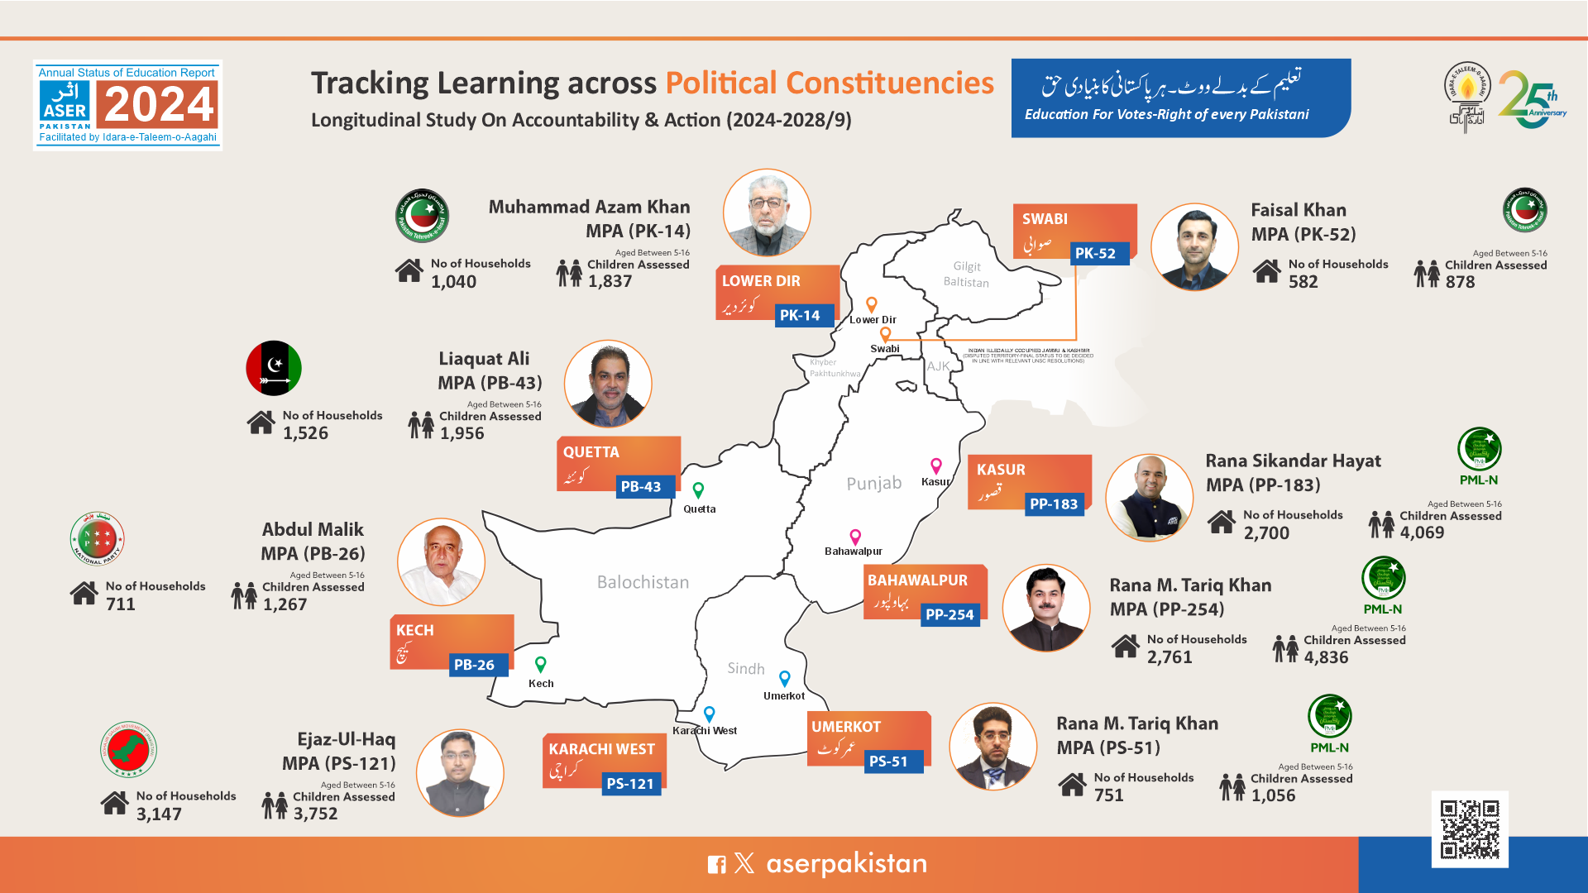
Tarakai
Muhammad Tairmur Talpur

Slide 8
Data Collection Tools and Instruments
Household Surveys
Parents and Community Members
Middle-Tier Actors and District Officials
Focus Group Discussions
(FGDs)
School Surveys
Assessments conducted in 3 schools per constituency as a rule (High, Middle, Primary)
Where this was not possible, other schools were included in the sample
Government School Case Studies

Slide 9
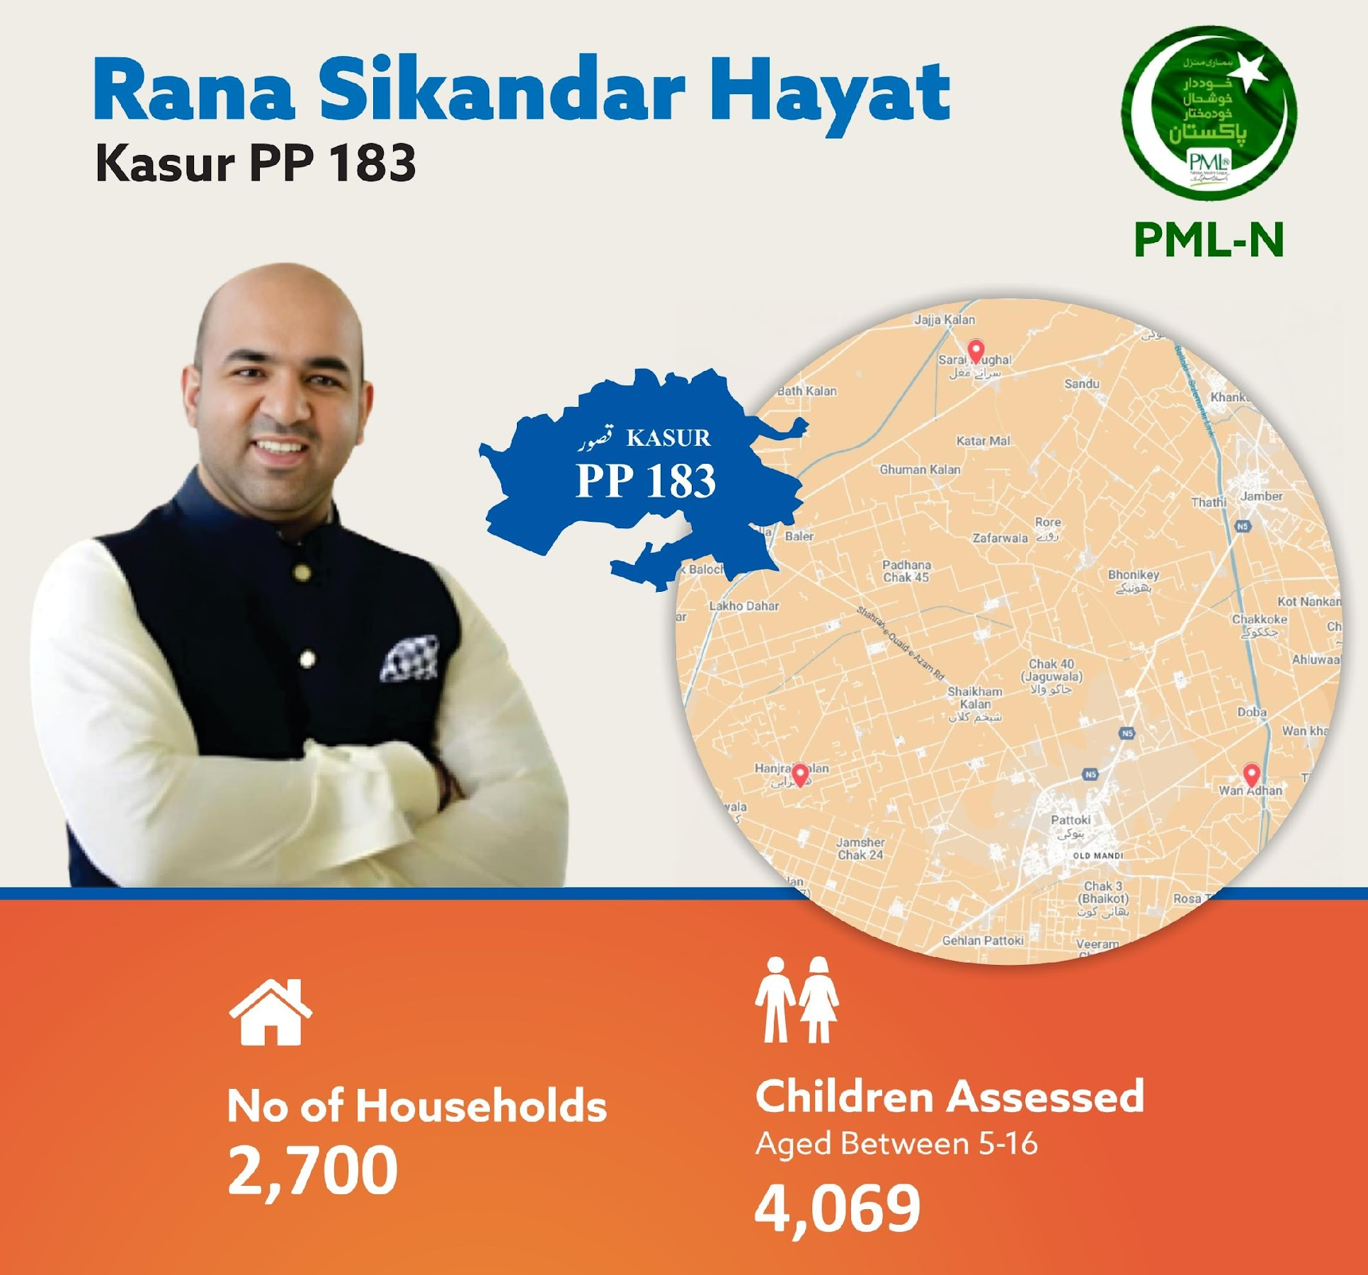



Key Findings
Early Years Schooling for ages 3-5:
73% Out of school
48% in government schools
52% in Private School
Enrollment Rate for ages 6-16
14.4% Out-of-School Children
85.6% Enrolled in schools
76.6%% in government schools
23.4%% in Private School
Girls OOS = 7% Boys OOS= 7%

Slide 10
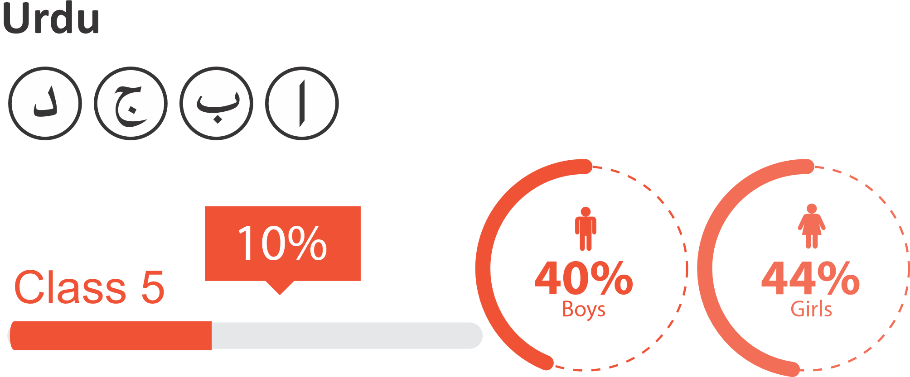
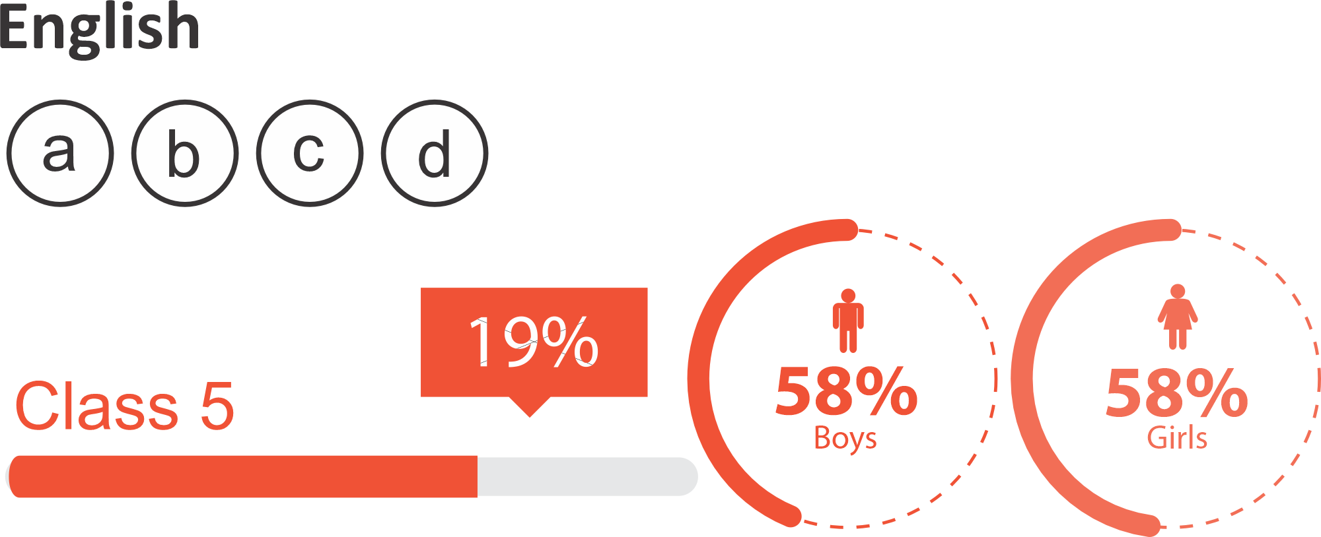
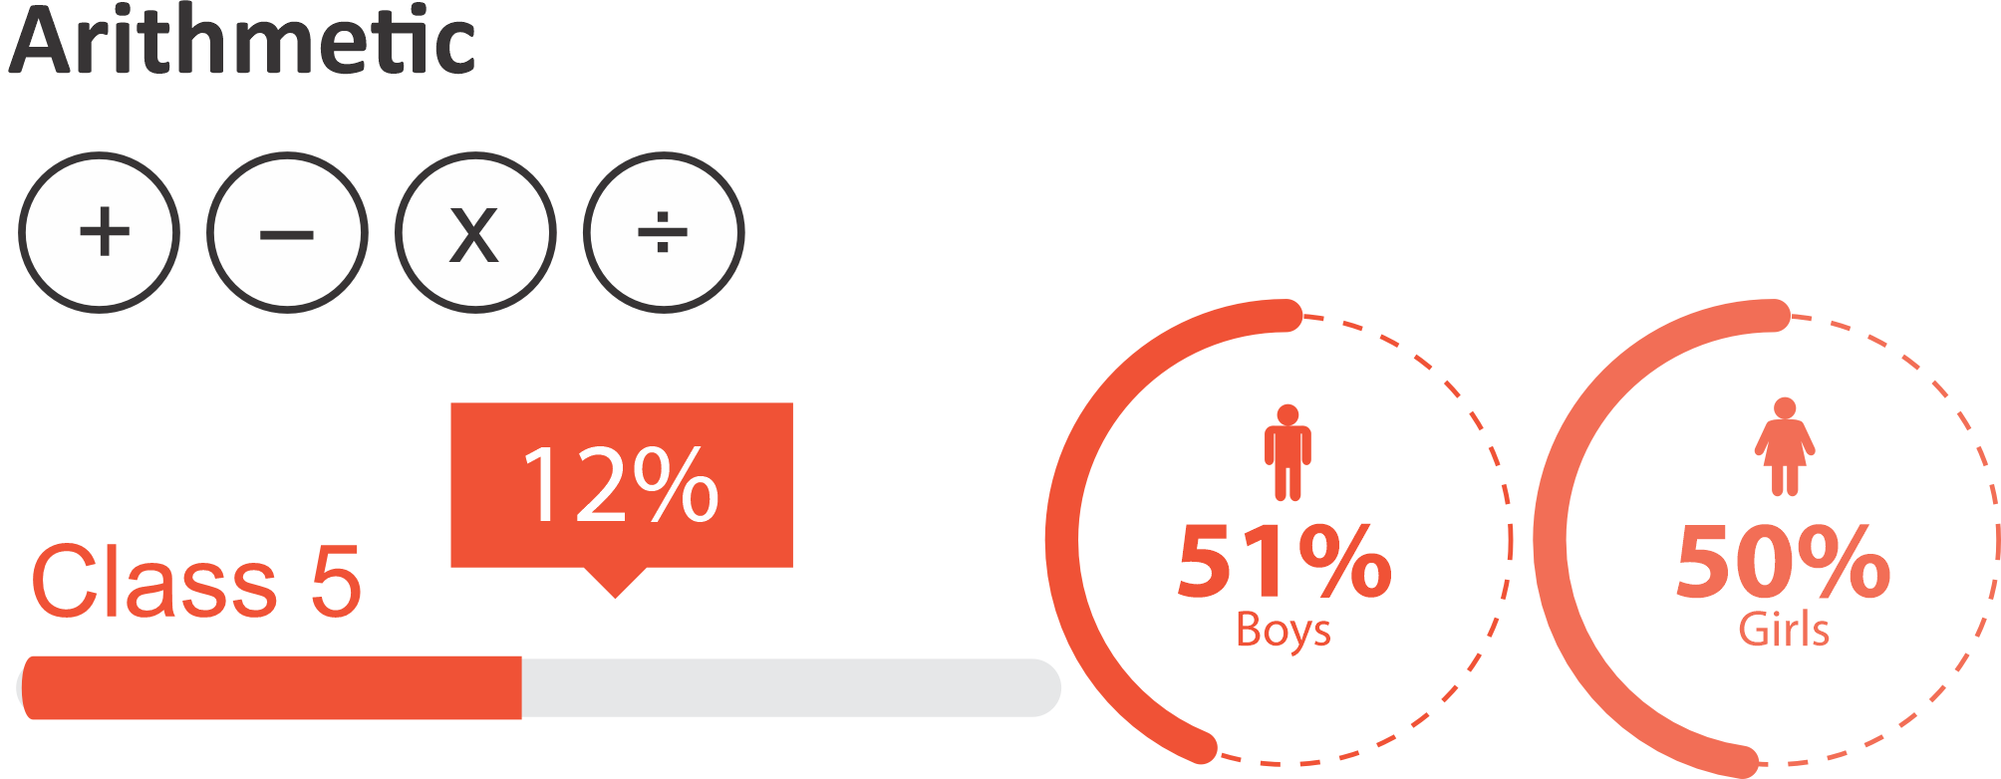
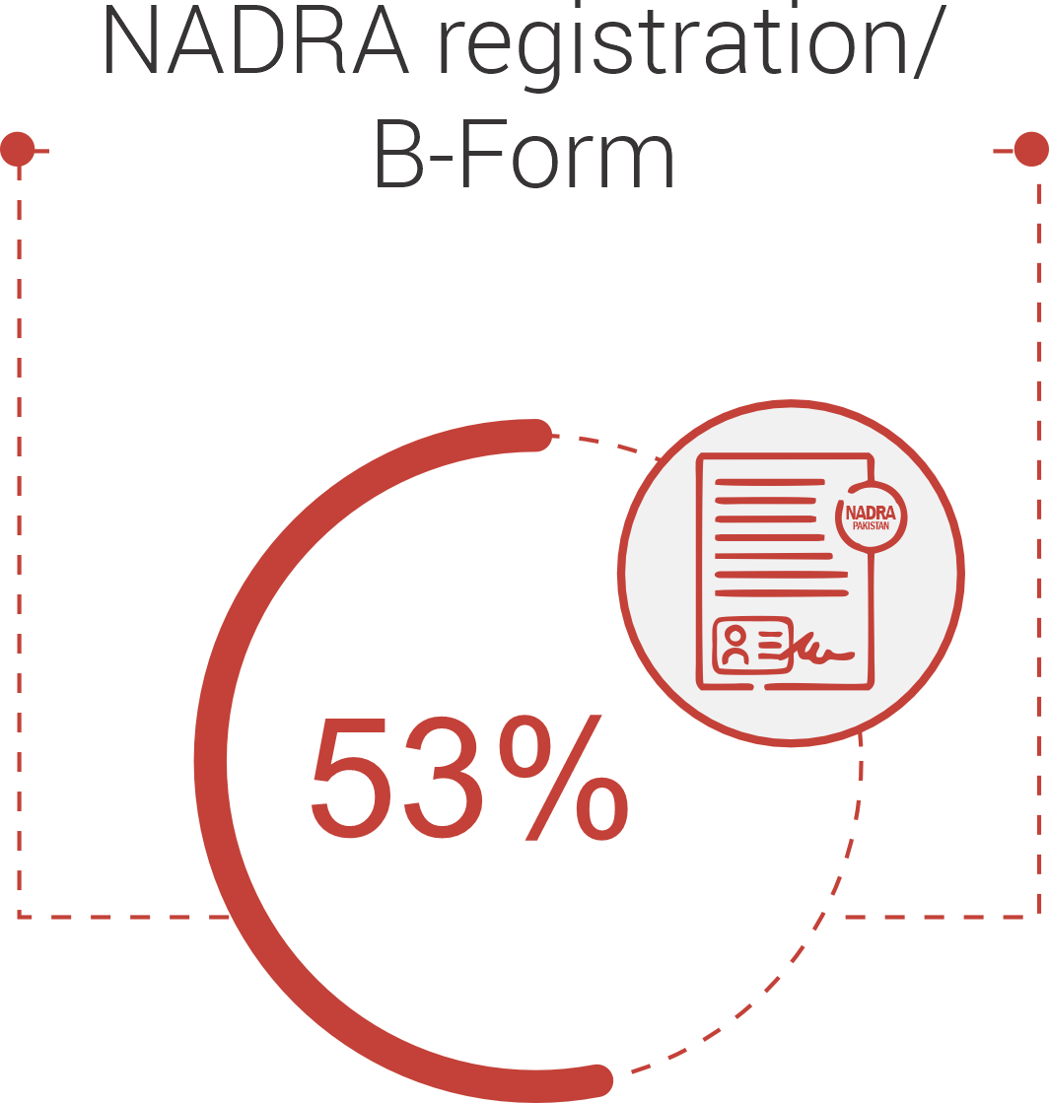
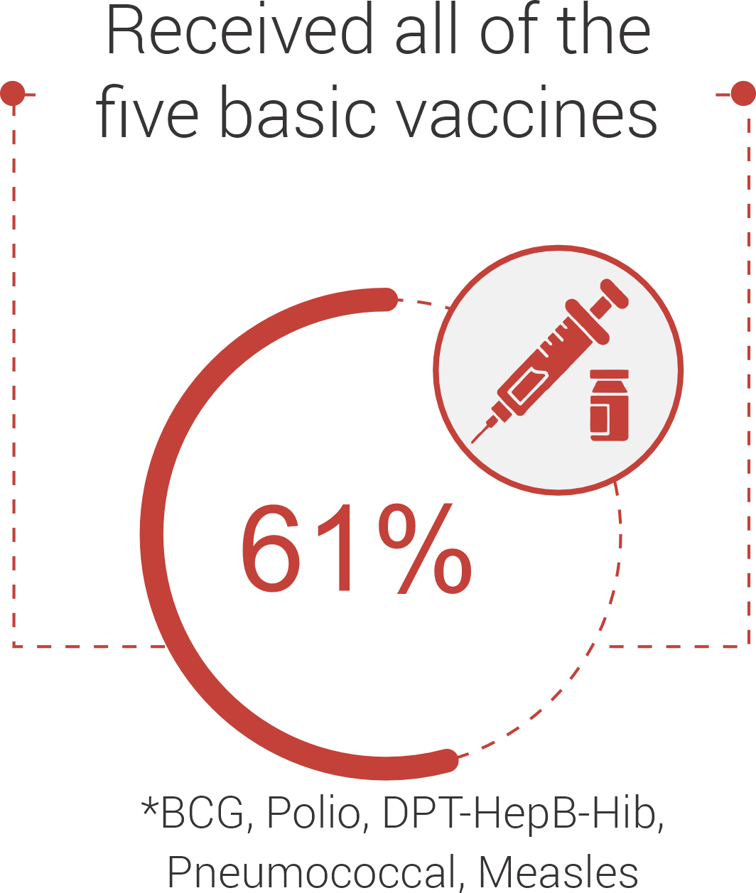

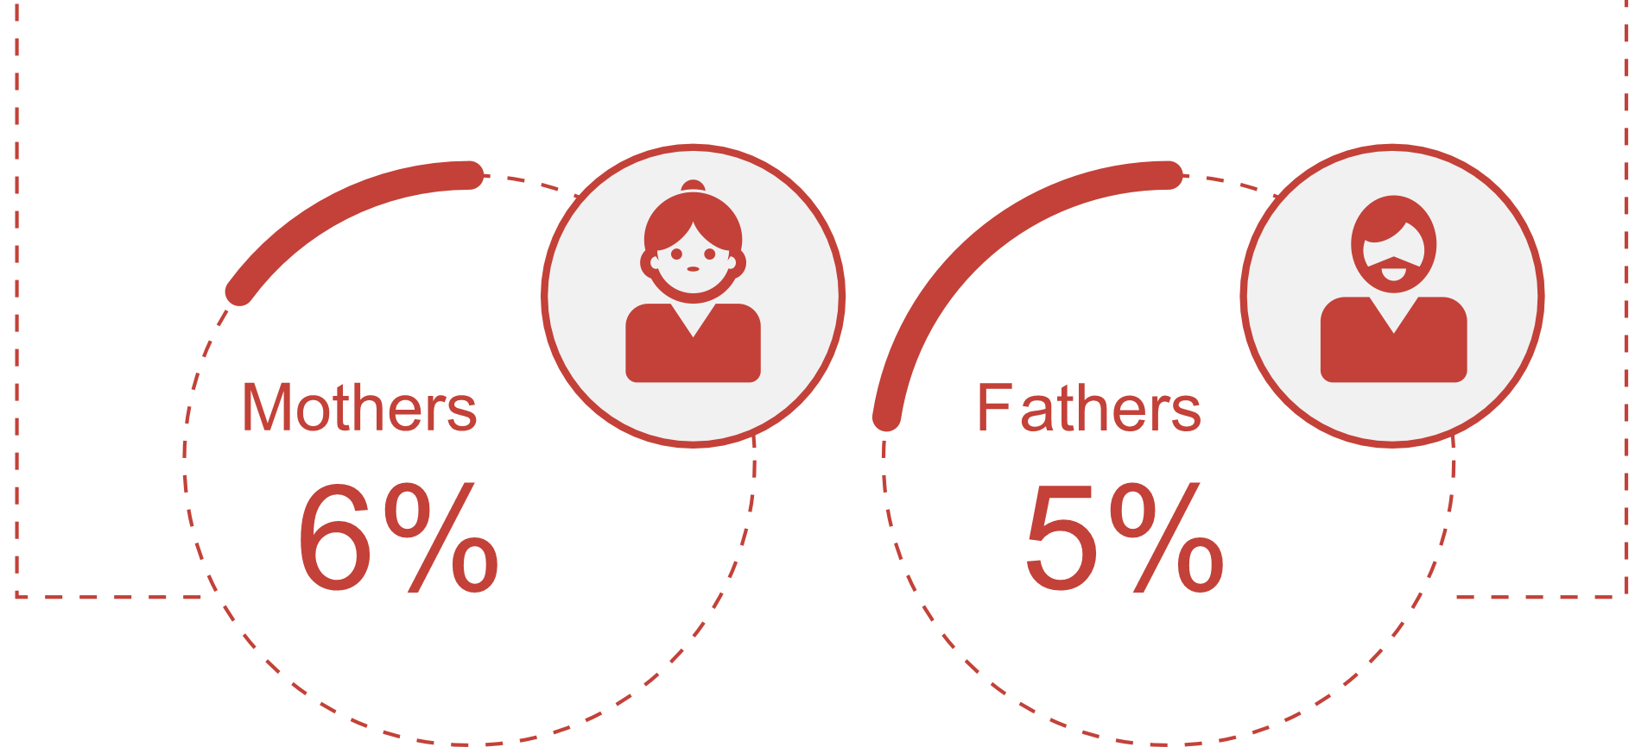
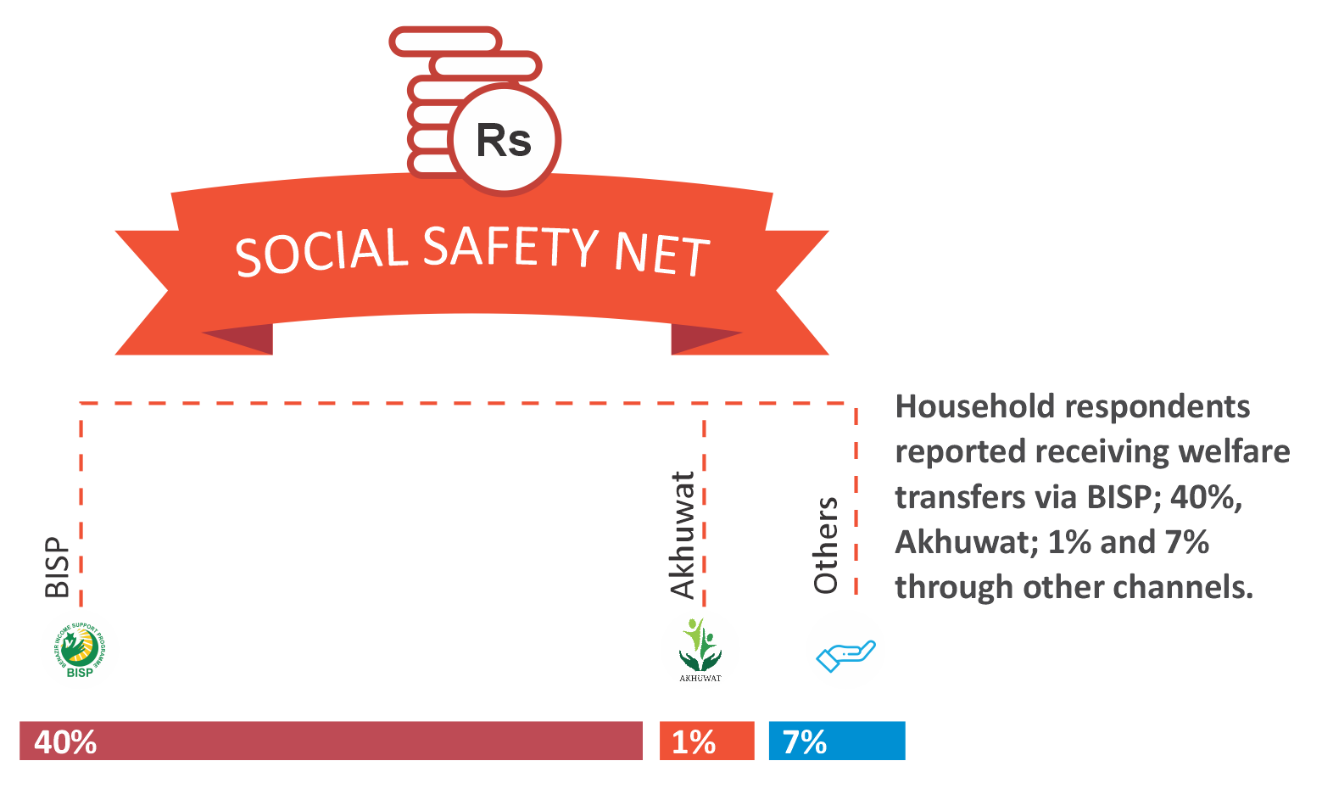





Key Findings
Girls outperform boys in Urdu learning, with 44% girls able to read sentences, compared to 40% of boys
Overall Learning (5-16): 42%
Overall Learning (5-16): 58%
Overall Learning (5-16): 50%
Can read story
Can read at least sentences
Can read sentence
Can do division (2 digits)
Can read at least words
Can at least so subtraction
Parents with below matric education
Mobile Phones
83%
Smart Phones
25%
Internet Connection
5%
Computers
1%
TV
100%

Slide 11
Kasur IX, Punjab - PP 183
Government School Name | Facilities |  |  |  |  |  | Teacher's Qualification | SMC
 | Playground | Electricity | Library | Clean Drinking Water | Separate Toilets For Girls & Boys | Boundary Wall
GHS Hanjory Kalan | Yes | Yes | Yes | Yes | Yes | Yes | MA or above = 24 Teachers B.Ed = 10 Teachers M.Ed = 9 Teachers | Active
GGES Wan Adhan | Yes | Yes | No | Yes | Yes | Yes | MA or above = 14 Teachers B.Ed = 1 Teachers M.Ed = 14 Teachers | Inactive
GPS Sarai Mughal (Sarai Noshera) | Yes | Yes | No | Yes | No | Yes | MA or above = 3 Teachers B.Ed = 1 Teachers M.Ed = 2 Teachers | Inactive
GHS Hanjory Kalan
100% of Grade 5 students could read Urdu story.
90% of Grade 5 students could read English sentences.
0% of Grade 5 students could do division.
GGES Wan Adhan
100% of Grade 5 students could read Urdu story.
100% of Grade 5 students could read English sentences.
30% of Grade 5 students could do division.
GPS Sarai Mughal
90% of Grade 5 students could read Urdu story.
40% of Grade 5 students could read English sentences.
70% of Grade 5 students could do division.

Slide 12
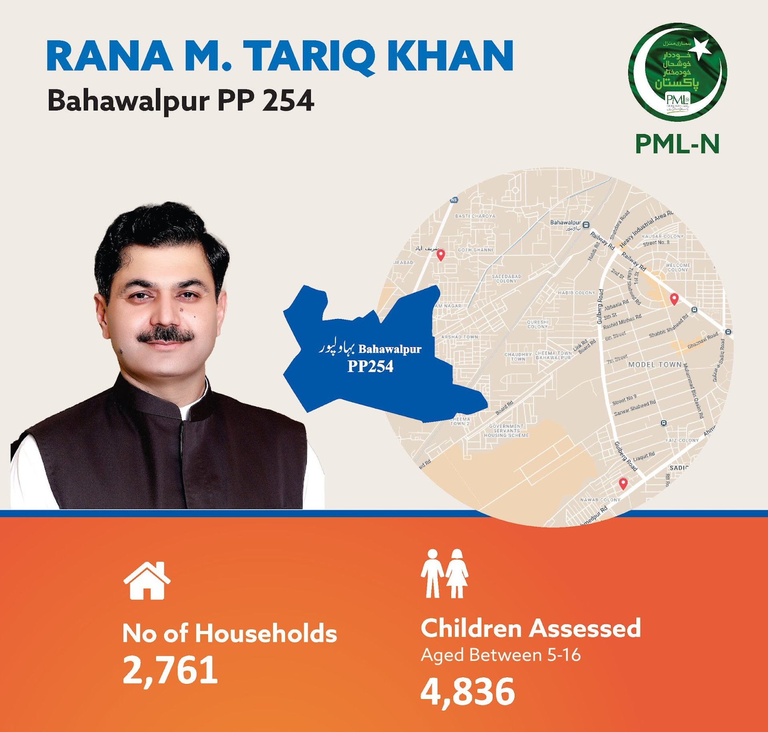
Key Findings
Early Years Schooling for ages 3-5:
79% Out of school
38% in government schools
62% in Private School
Enrollment Rate for ages 6-16
13% Out-of-School Children
87% Enrolled in schools
58% in government schools
42% in Private School
Girls OOS = 6% Boys OOS= 7%

Slide 13
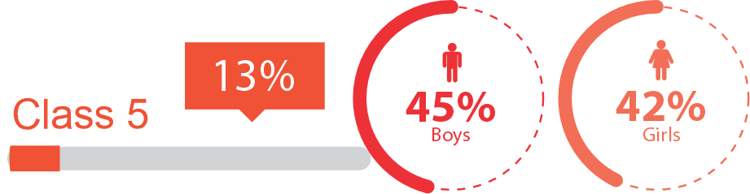
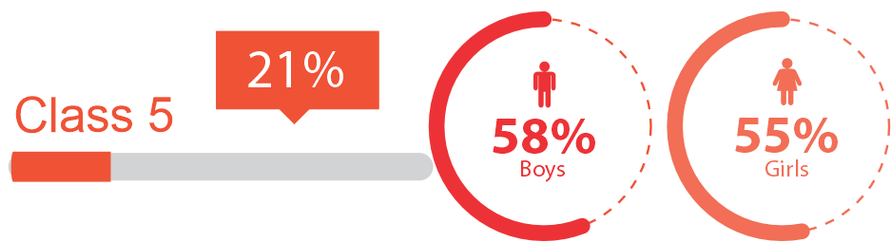
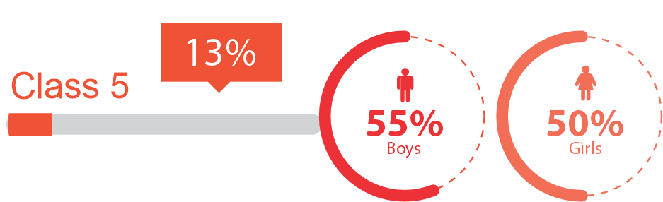
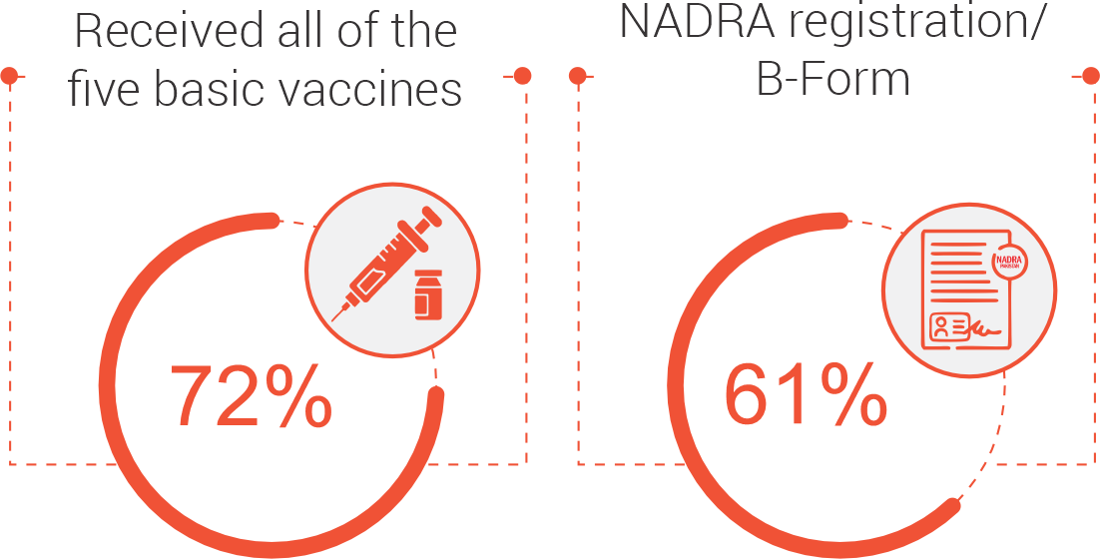

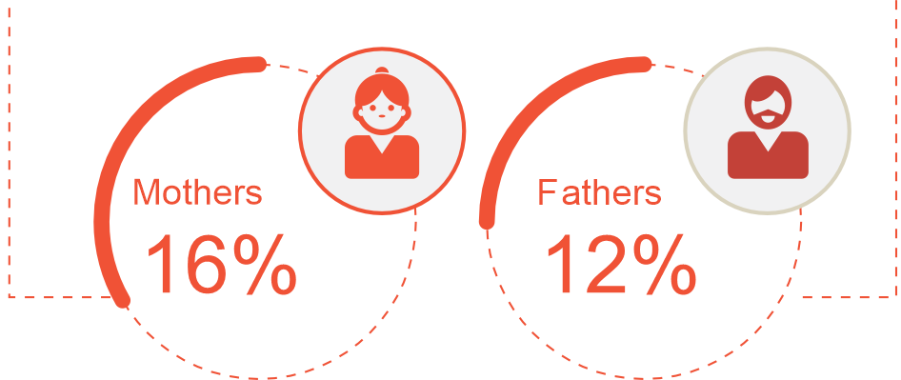
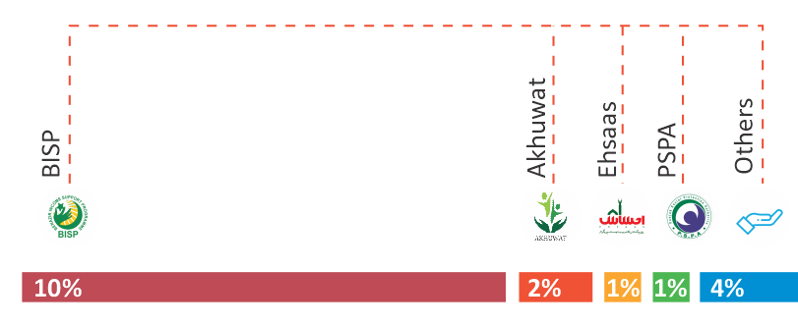
Key Findings
Overall Learning (5-16): 44%
Overall Learning (5-16): 56%
Overall Learning (5-16): 51%
Can read story
Can read at least sentences
Can read sentence
Can do division (2 digits)
Can read at least words
Can at least so subtraction
Parents with below matric education
Mobile Phones
71%
Smart Phones
59%
Internet Connection
39%
Computers
12%
TVs
99%

Slide 14
Bahawalpur X, Punjab - PP 254
Government School Name | Facilities |  |  |  |  |  | Teacher's Qualification | SMC
 | Playground | Electricity | Library | Clean Drinking Water | Separate Toilets For Girls & Boys | Boundary Wall
GHSS Abbasiya | Yes | Yes | Yes | Yes | No | Yes | MA or above = 85 Teachers B.Ed = 75 Teachers M.Ed = 16 Teachers | Active
GGES Goth Ghani | No | Yes | Yes | Yes | Yes | Yes | MA or above = 15 Teachers B.Ed = 08 Teachers M.Ed = 07 Teachers | Inactive
GBPS Bhatta No. 1 | No | Yes | Yes | Yes | No | Yes | MA or above = 06 Teachers B.Ed = 06 Teachers M.Ed = 04 Teachers | Active
GHSS Abbasiya
100% of Grade 5 students could read Urdu story.
100% of Grade 5 students could read English sentences.
80% of Grade 5 students could do division.
GGES Goth Ghani
100% of Grade 5 students could read Urdu story.
100% of Grade 5 students could read English sentences.
100% of Grade 5 students could do division.
GBPS Bhatta No. 1
80% of Grade 5 students could read Urdu story.
80% of Grade 5 students could read English sentences.
50% of Grade 5 students could do division

Slide 15
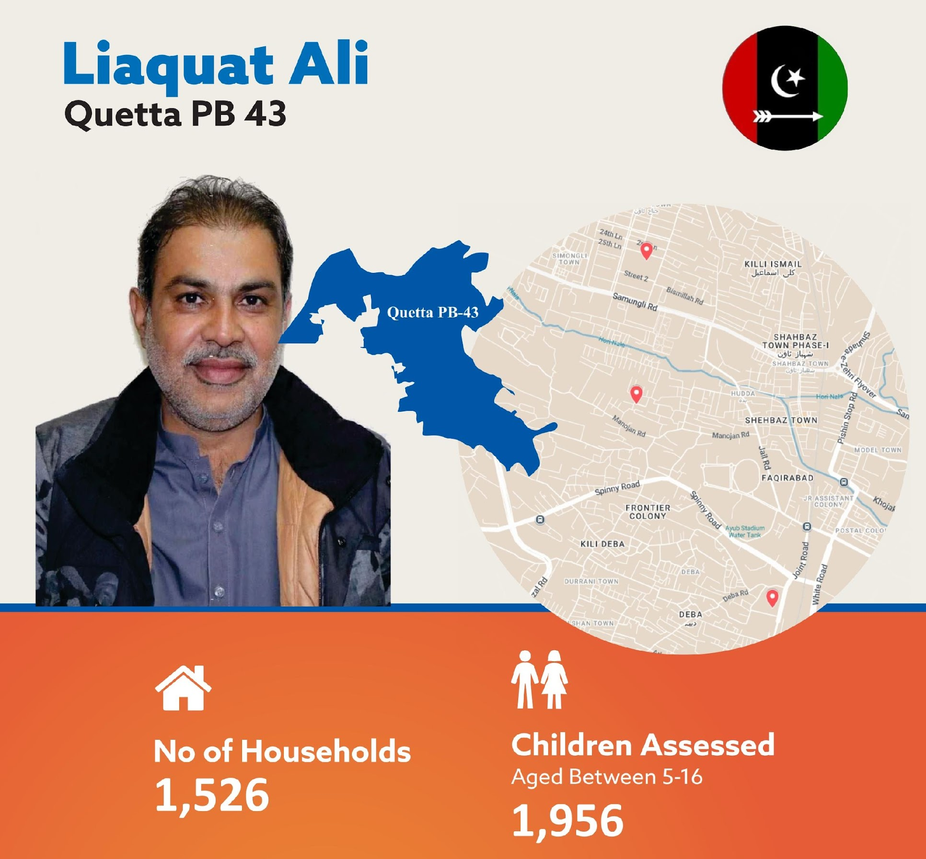
Key Findings
Early Years Schooling for ages 3-5:
89% Out of school
45% in government schools
55% in Private School
Enrollment Rate for ages 6-16
13% Out-of-School Children
87% Enrolled in schools
40% in government schools
60% in Private School
Girls OOS = 5% Boys OOS= 7%

Slide 16
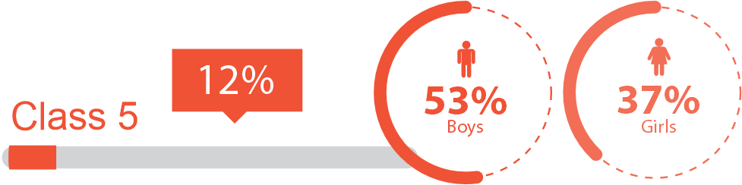
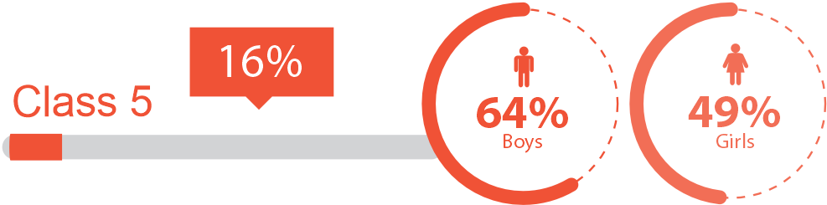
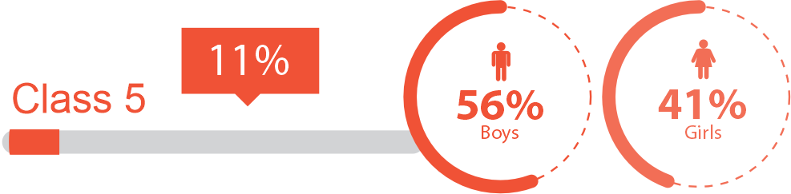
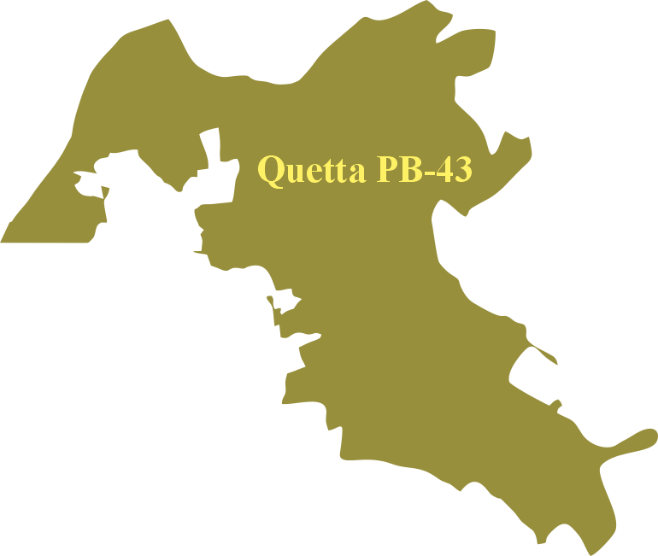
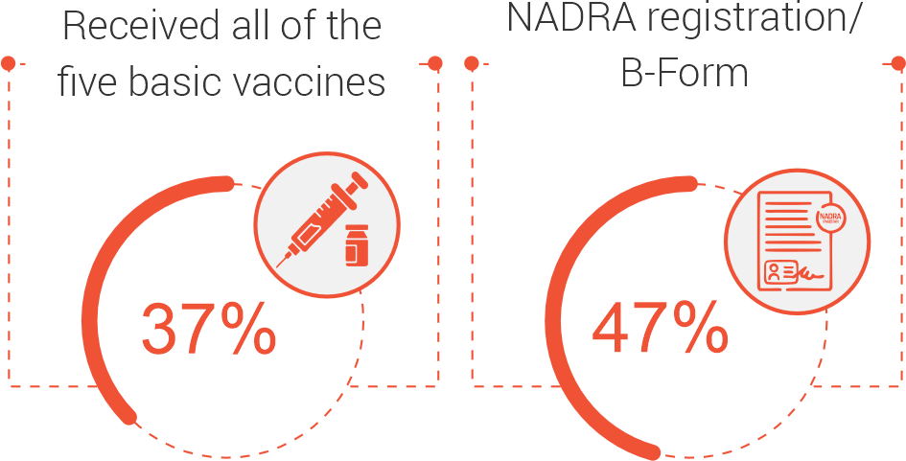
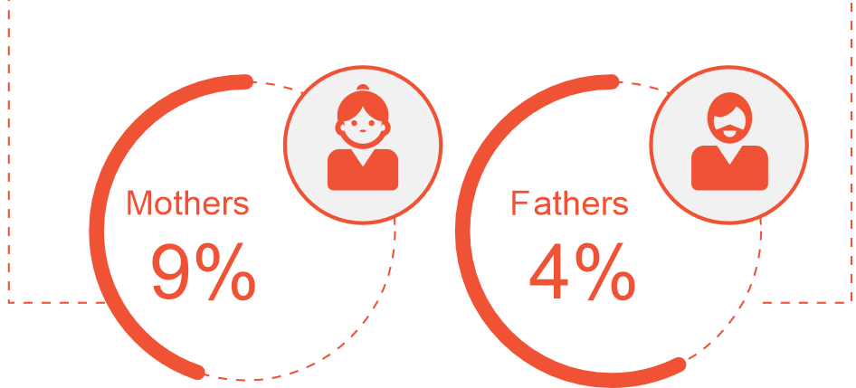
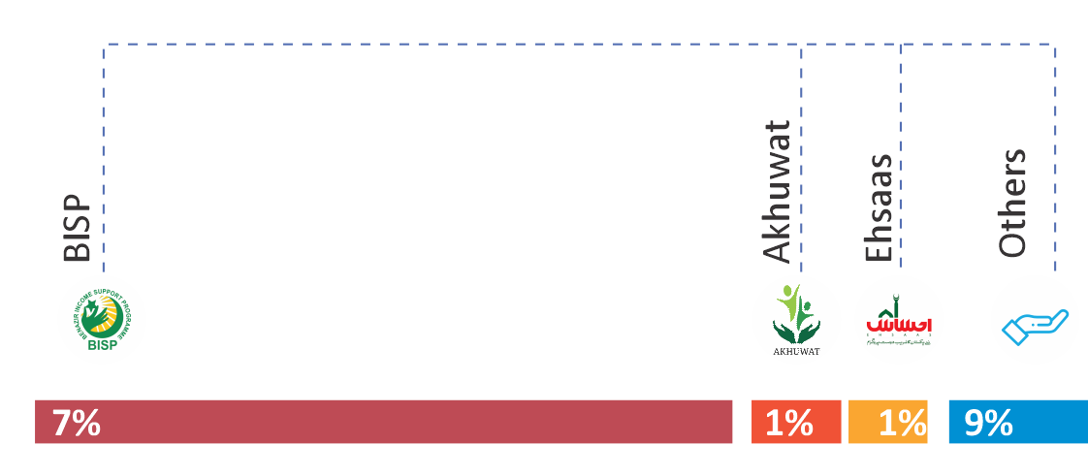
Key Findings
Overall Learning (5-16): 45%
Overall Learning (5-16): 57%
Overall Learning (5-16): 49%
Can read story
Can read at least sentences
Can read sentence
Can do division (2 digits)
Can read at least words
Can at least so subtraction
Parents with below matric education
Mobile Phones
73%
Smart Phones
88%
Internet Connection
69%
Computers
48%
TVs
100%

Slide 17
Quetta 6, Balochistan - PB 43
Government School Name | Facilities |  |  |  |  |  | Teachers’ Qualification | PTSMC
 | Playground | Electricity | Library | Clean Drinking Water | Separate Toilets For Girls & Boys | Boundary Wall
GGHS Jinnah Town | No | Yes | Yes | Yes | Yes | Yes | MA or above = 38 Teachers B.Ed = 28 Teachers M.Ed = 19 Teachers | Inactive
GBMS Railway Colony | Yes | Yes | No | Yes | No | Yes | MA or above = 23 Teachers M.Ed = 16 Teachers | Inactive
GGPS Eid Gah Muhla Huda | No | Yes | No | Yes | No | Yes | MA or above = 06 Teachers M.Ed = 01 Teachers | Inactive
GGHS Jinnah Town, Quetta
68% of Grade 5 students could read Urdu story
56% of Grade 5 students could read English sentences.
56% of Grade 5 students could do division.
GBMS Railway Colony Quetta
60% of Grade 6 students could read Urdu story.
47% of Grade 6 students could read English sentences.
43% of Grade 6 students could do division.

Slide 18
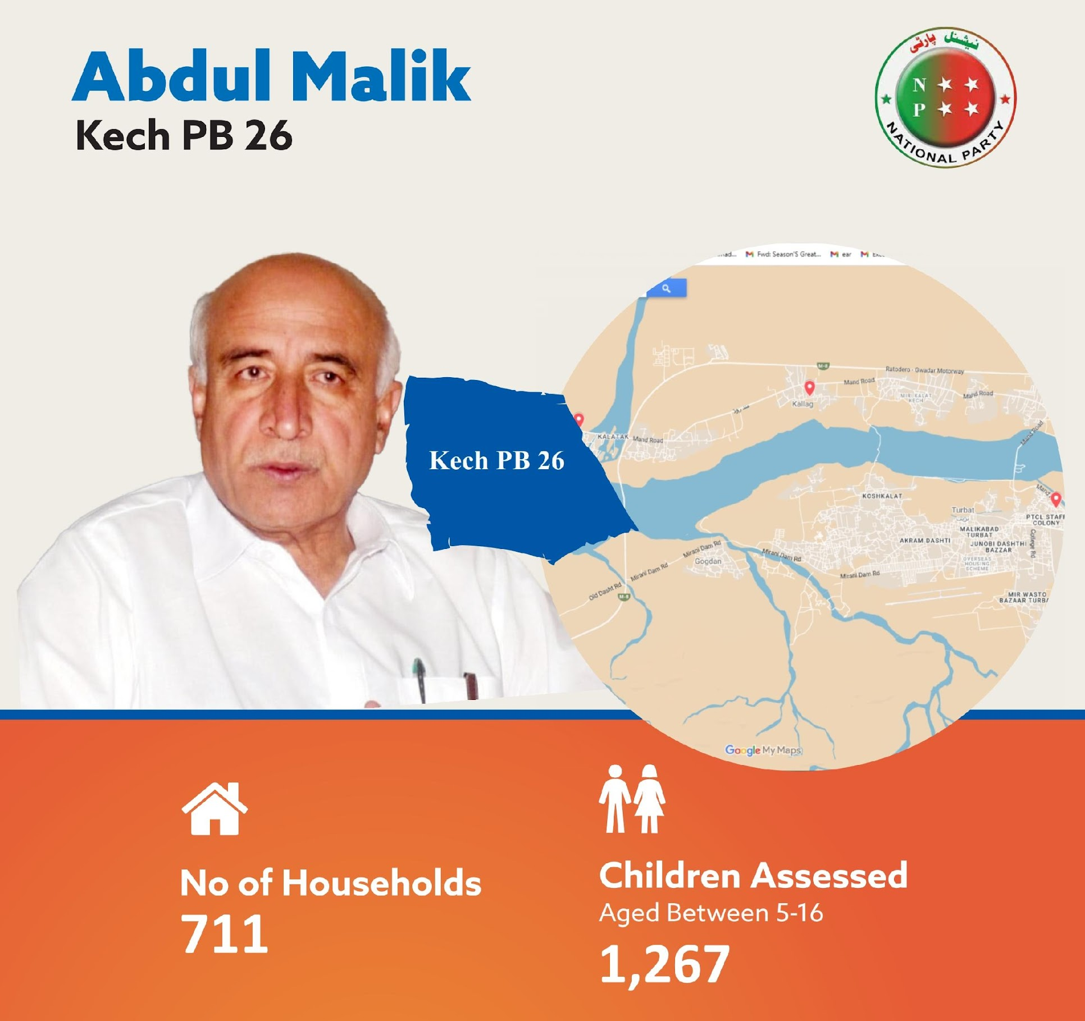
Key Findings
Early Years Schooling for ages 3-5:
62% Out of school
58% in government schools
42% in Private School
Enrollment Rate for ages 6-16
9% Out-of-School Children
91% Enrolled in schools
68% in government schools
32% in Private School
Girls OOS = 5% Boys OOS= 4%

Slide 19
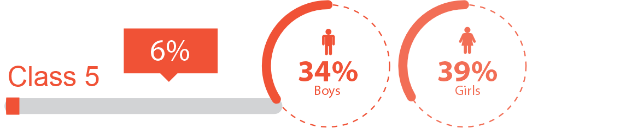
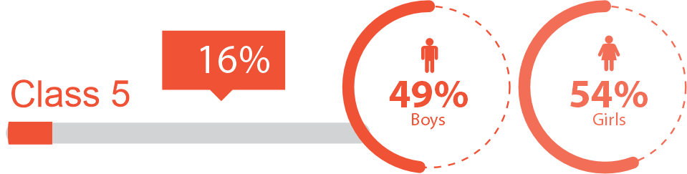
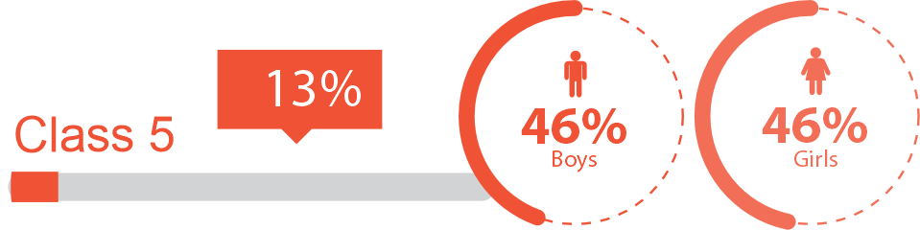

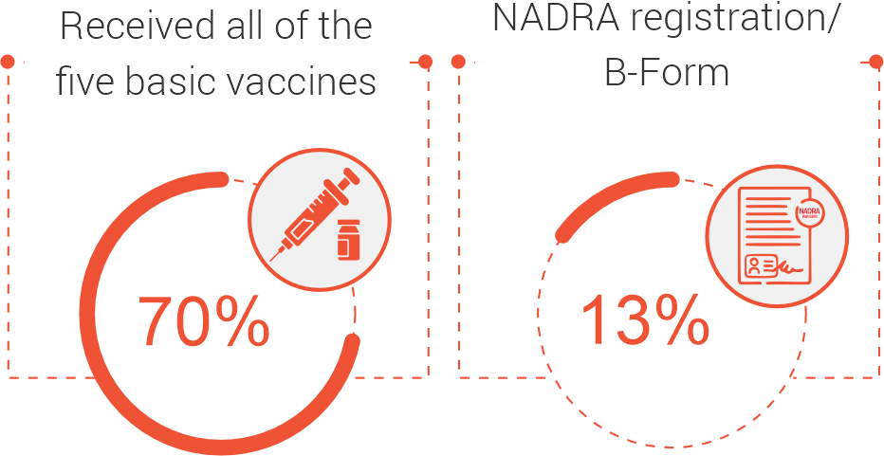
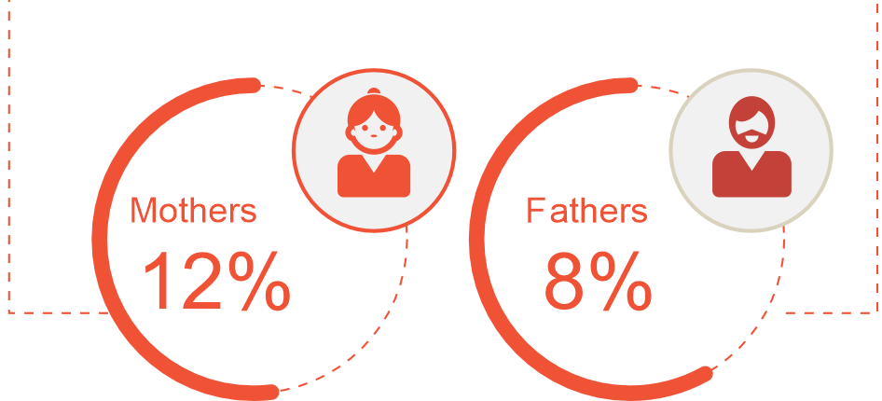
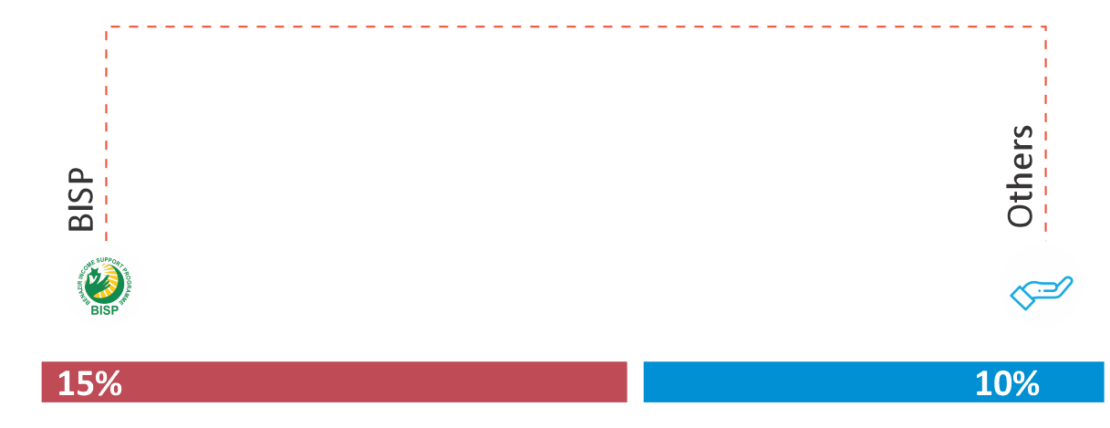
Key Findings
Girls outperform boys in both English and Urdu, with 54% girls able to read at least words in English and 39% girls able to read at least sentences in Urdu.
Overall Learning (5-16): 36%
Overall Learning (5-16): 52%
Overall Learning (5-16): 46%
Can read story
Can read at least sentences
Can read sentence
Can do division (2 digits)
Can read at least words
Can at least so subtraction
Parents with below matric education
Mobile Phones
71%
Smart Phones
77%
Internet Connection
32%
Computers
15%
TVs
100%

Slide 20
Kech 2, Balochistan - PB 26
Government School Name | Facilities |  |  |  |  |  | Teacher's Qualification | SMC
 | Playground | Electricity | Library | Clean Drinking Water | Separate Toilets For Girls & Boys | Boundary Wall
GGHS Kallag | No | Yes | No | Yes | No | Yes | MA or above = 07 Teachers BA = 10 Teachers B.Ed = 08 Teachers | Active
GGMS Raisani Bazar Singani Sar | No | Yes | No | Yes | No | Yes | MA or above = 30 Teachers M.Ed = 30 Teachers | Active
GPS Ginna Puhllani | No | Yes | No | Yes | No | Yes | BA = 01 Teachers FA = 02 Teachers Matric = 01 Teachers PTC = 01 Teachers | Active
GGHS Kallag
17% of Grade 5 students could read Urdu story.
25% of Grade 5 students could read English sentences.
0% of Grade 5 students could do division.
GGMS Raisani Bazar Singani Sar
10% of Grade 5 students could read Urdu story.
0% of Grade 5 students could read English sentences.
0% of Grade 5 students could do division.
GPS Ginna Puhllani
40% of Grade 5 students could read Urdu story.
70% of Grade 5 students could read English sentences.
40% of Grade 5 students could do division.

Slide 21
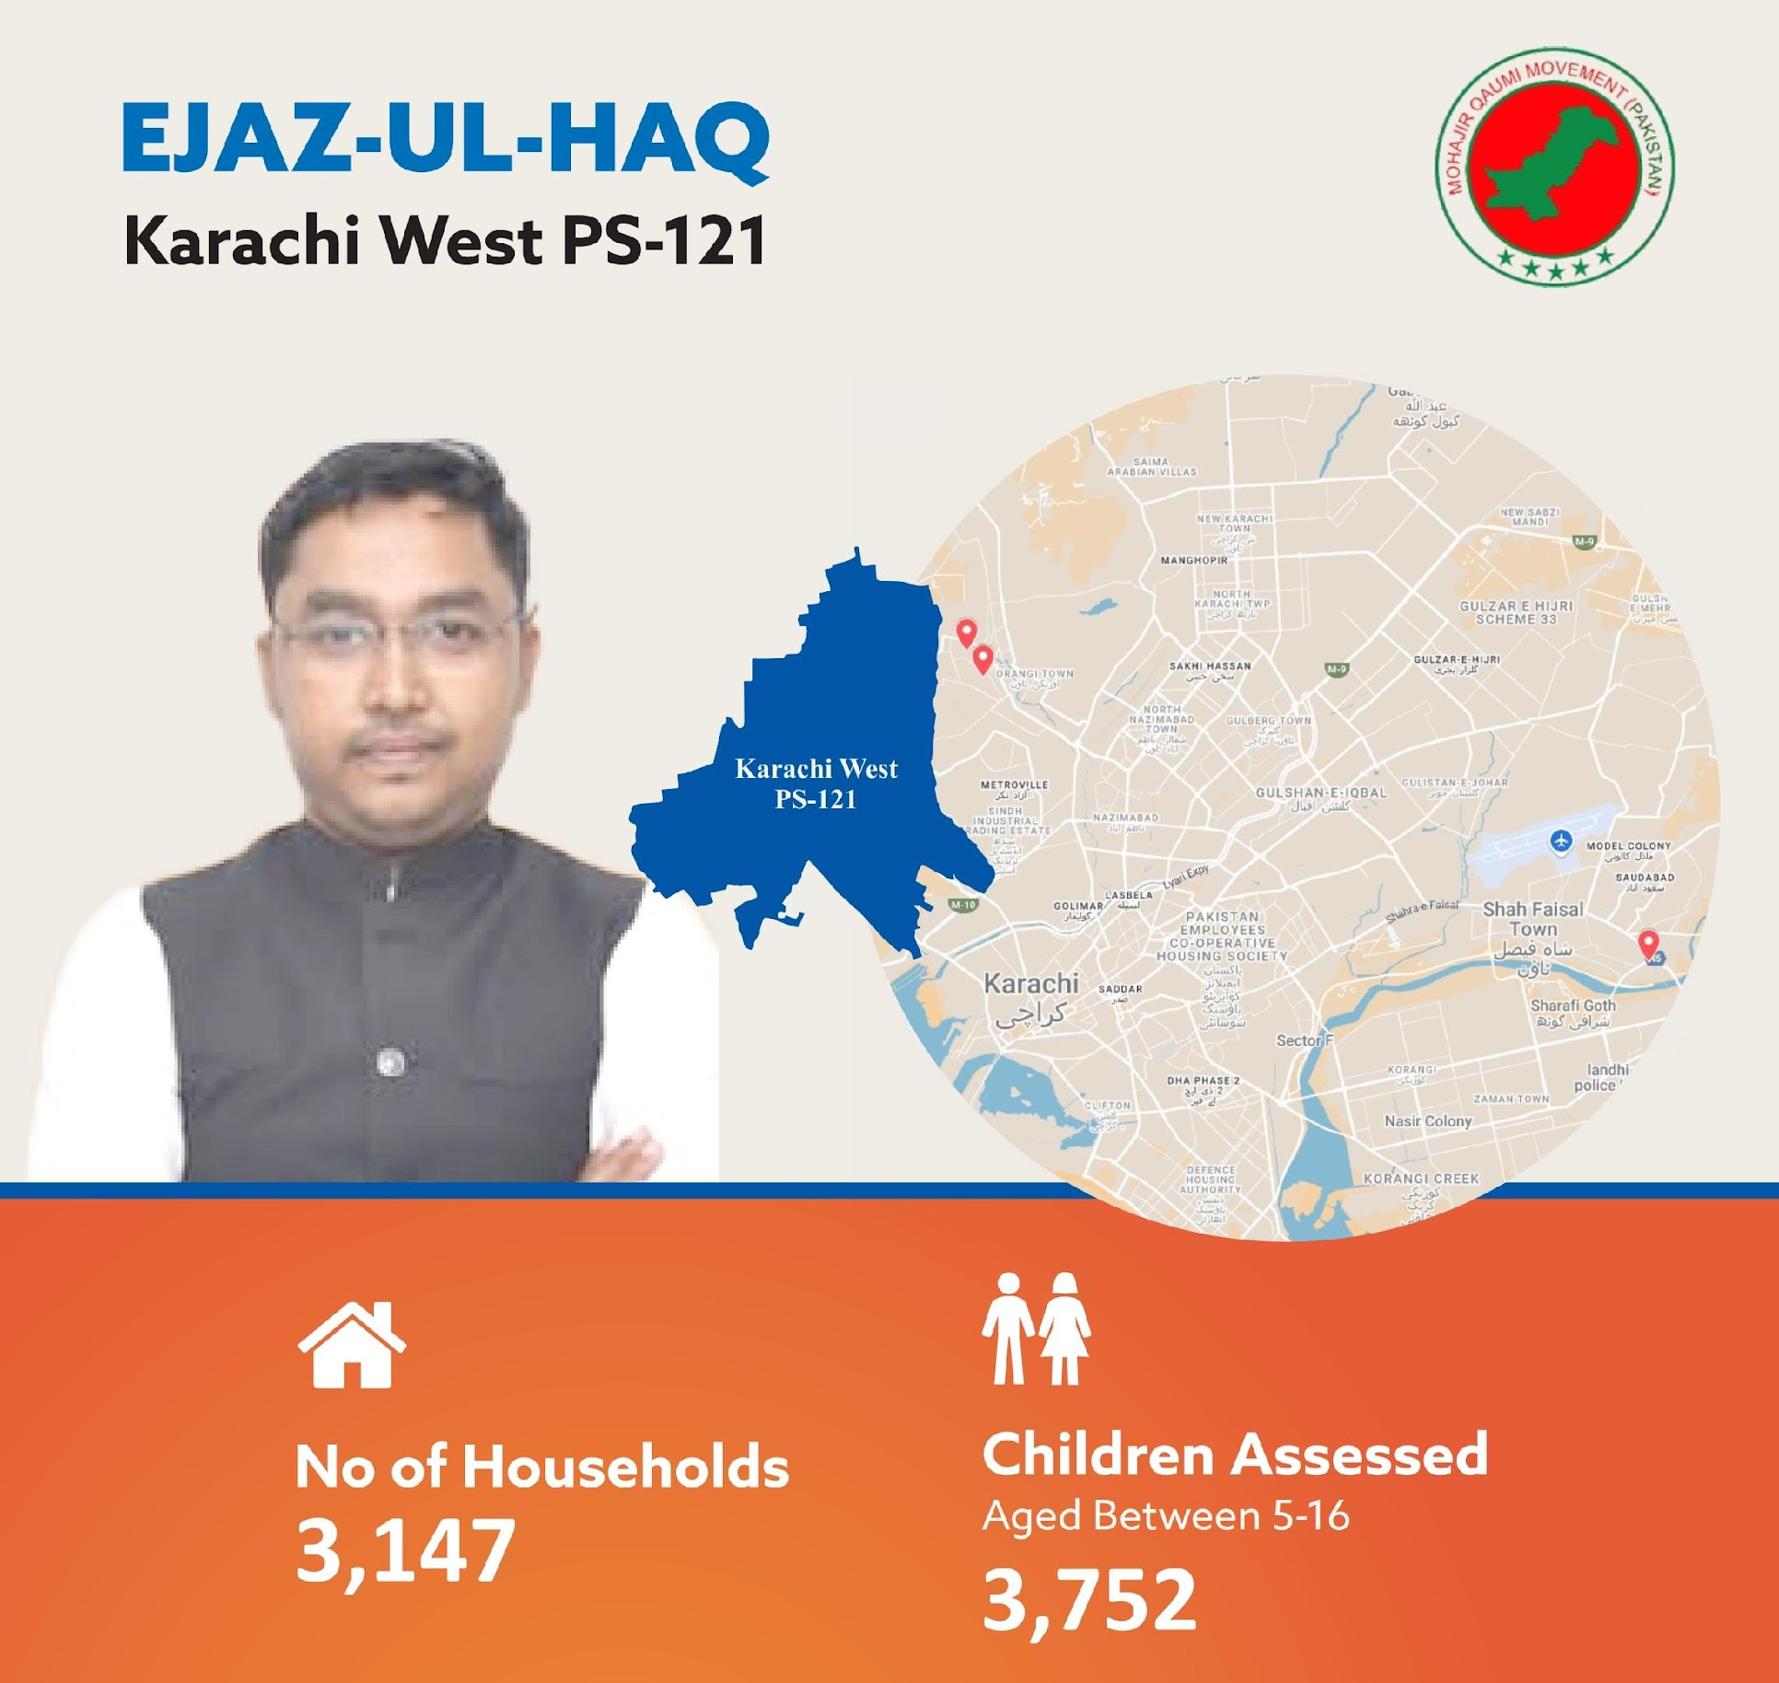
Key Findings
Early Years Schooling for ages 3-5:
90% Out of school
10% in government schools
90% in Private School
Enrollment Rate for ages 6-16
24% Out-of-School Children
76% Enrolled in schools
76% in government schools
24% in Private School
Girls OOS = 9% Boys OOS= 13%

Slide 22
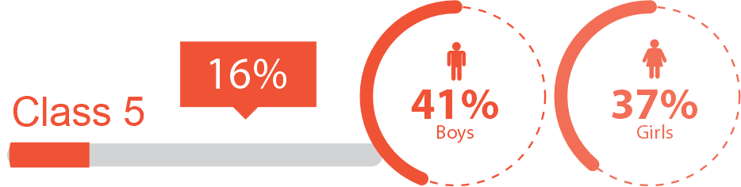
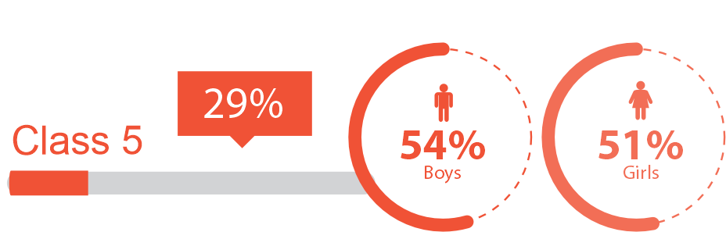
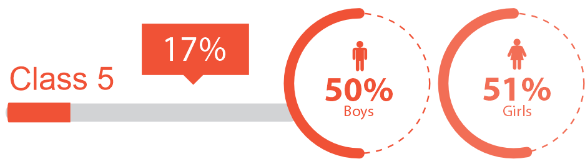
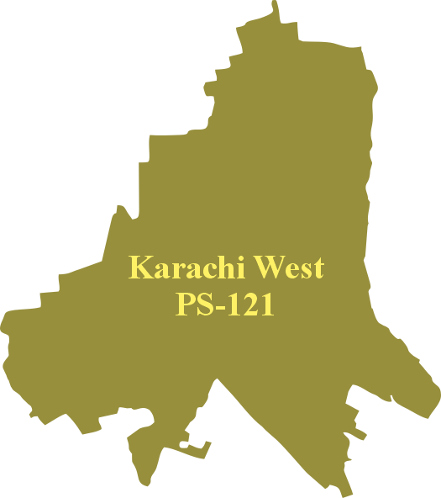
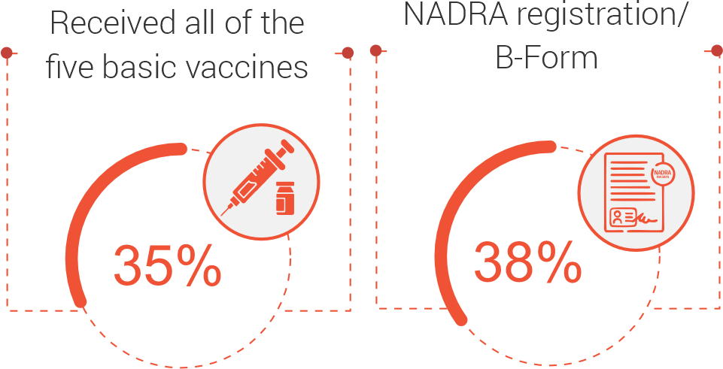
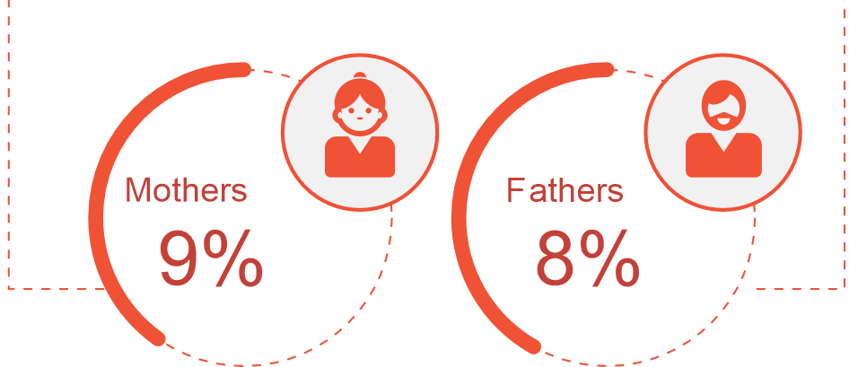
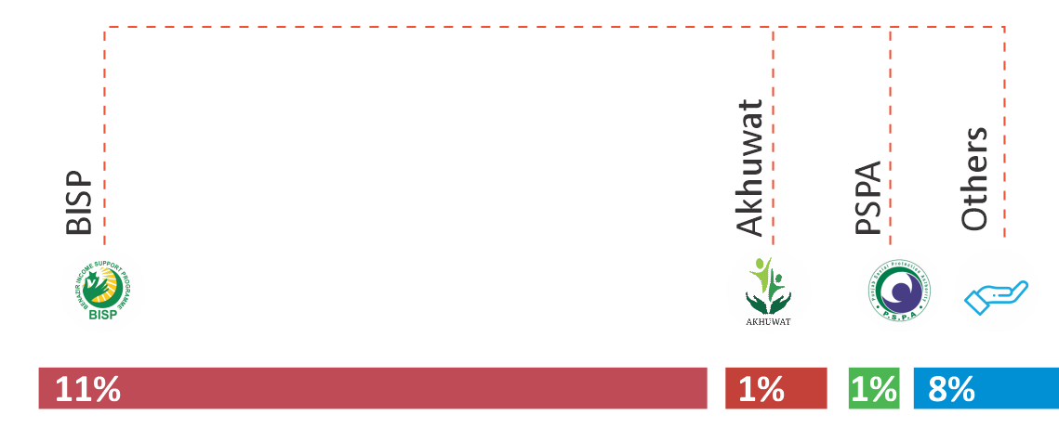
Key Findings
Girls outperform boys in arithmetic, with 51% girls able to solve subtraction problems compared to 50% boys
Overall Learning (5-16): 52%
Overall Learning (5-16): 39%
Overall Learning (5-16): 52%
Can read story
Can read at least sentences
Can read sentence
Can read at least words
Can do division (2 digits)
Can at least so subtraction
Parents with below matric education
Mobile Phones
73%
Smart Phones
64%
Internet Connection
49%
Computers
16%
TVs
100%

Slide 23
Karachi West, Sindh - PS 121
Government School Name | Facilities |  |  |  |  |  | Teacher's Qualification | SMC
 | Playground | Electricity | Library | Clean Drinking Water | Separate Toilets For Girls & Boys | Boundary Wall
GGHSS Baba Wilayat Ali Shah | Yes | Yes | Yes | No | Yes | Yes | MA or above = 10 Teachers B.Ed = 10 Teachers | Active
GBLSS Khursheed ul Islam | Yes | Yes | No | No | Yes | Yes | MA or above = 13 Teachers B.Ed = 11 Teachers M.Ed = 04 Teachers | Active
GBPS Islamia Baba Wilayat Ali Shah | Yes | No | No | No | No | Yes | MA or above = 01 Teachers BA = 03 Teachers B.Ed = 02 Teachers M.Ed = 01 Teachers | Active
GGHSS Baba Wilayat Ali Shah
(there are no grades 1, 3 or 5 in this school)
97% of Grade 6 students could read Urdu story.
87% of Grade 6 students could read English sentences.
37% of Grade 6 students could do division.
GBLSS Khursheed ul Islam
100% of Grade 5 students could read Urdu story.
100% of Grade 5 students could read English sentences.
60% of Grade 5 students could do division.
GBPS Islamia Baba Wilayat Ali Shah
70% of Grade 5 students could read Urdu story.
50% of Grade 5 students could read English sentences.
20% of Grade 5 students could do division.

Slide 24
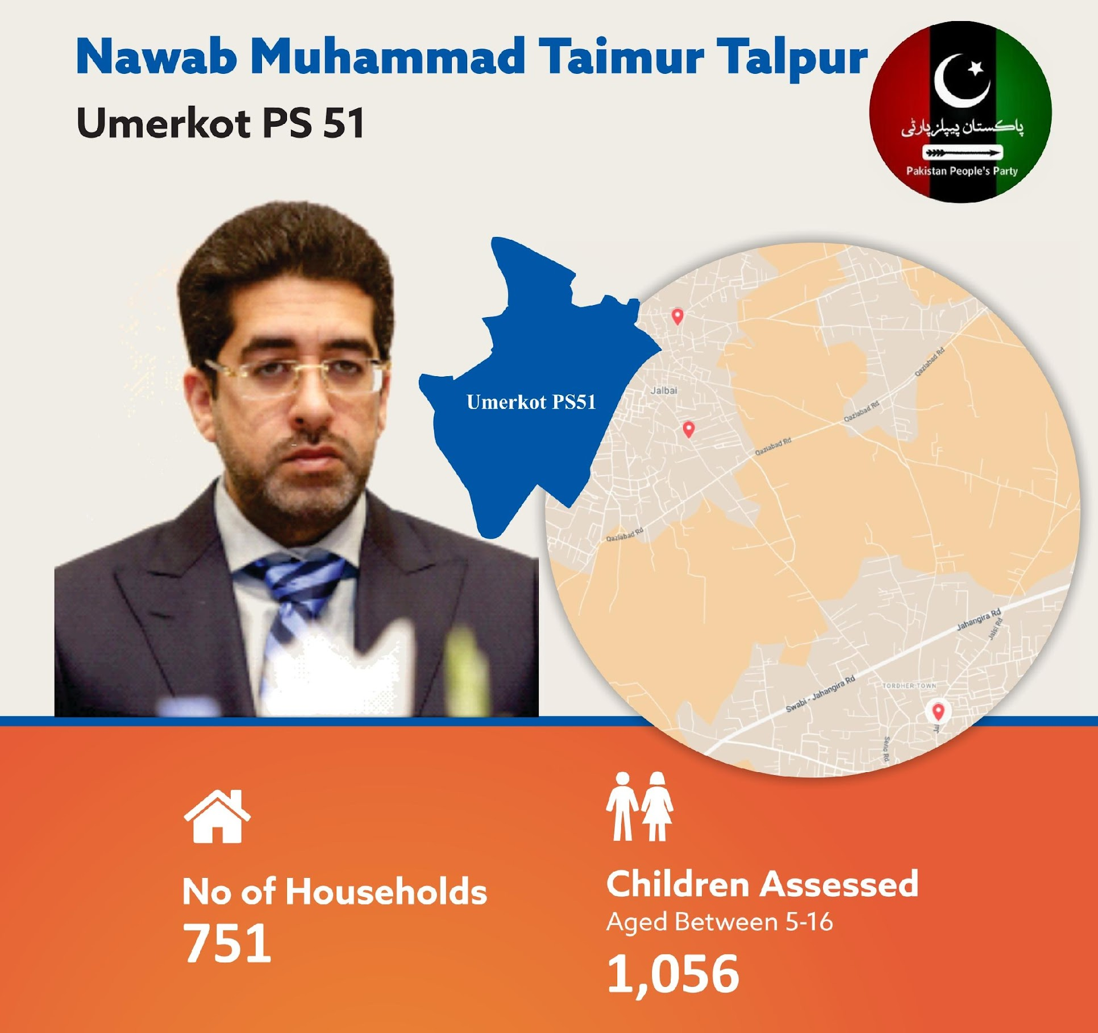
Key Findings
Early Years Schooling for ages 3-5:
91% Out of school
100% in government schools
0% in Private School
Enrollment Rate for ages 6-16
17% Out-of-School Children
83% Enrolled in schools
87% in government schools
13% in Private School
Girls OOS = 7% Boys OOS= 10%

Slide 25
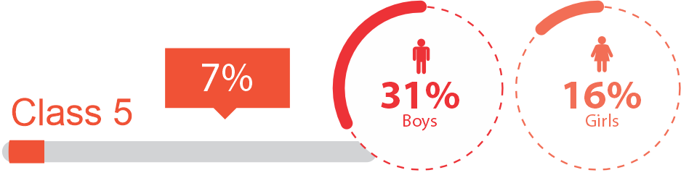
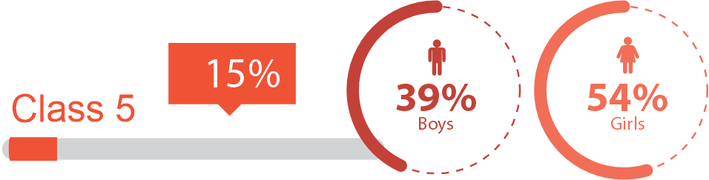
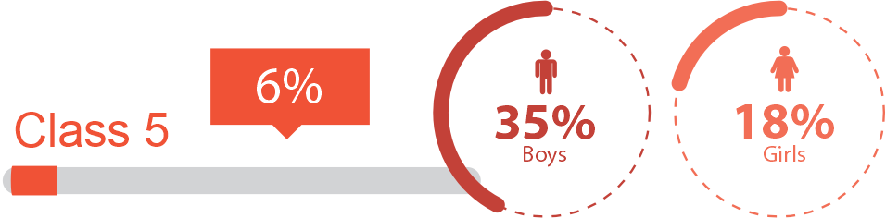
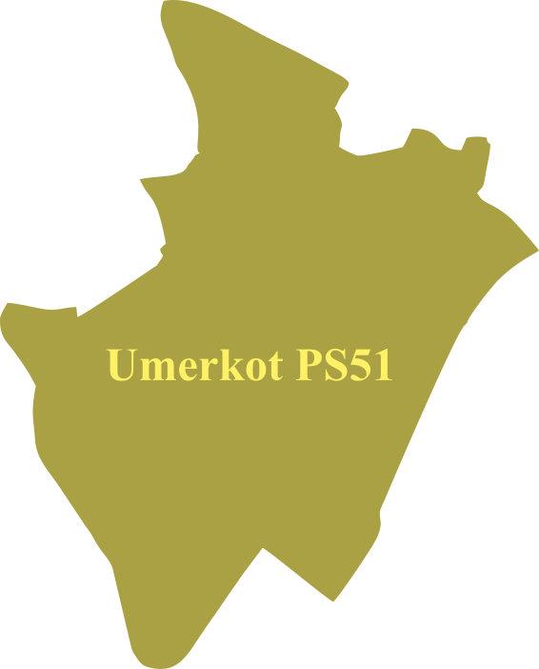
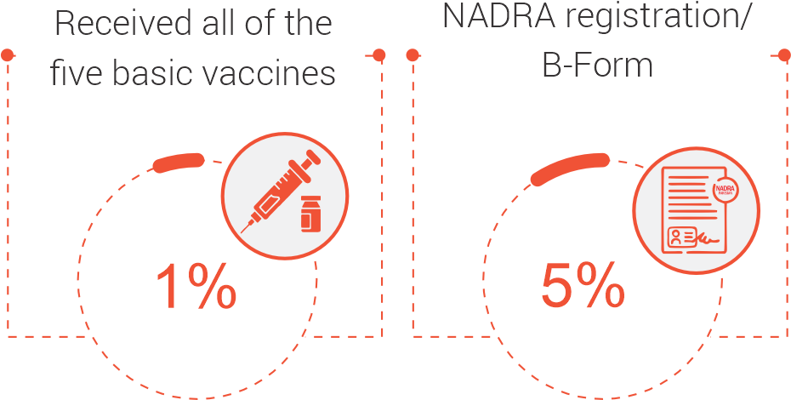
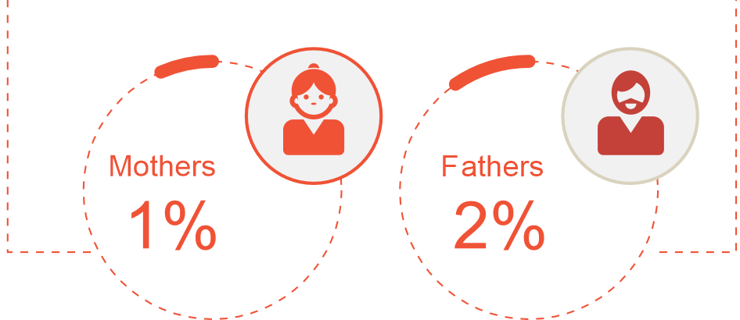
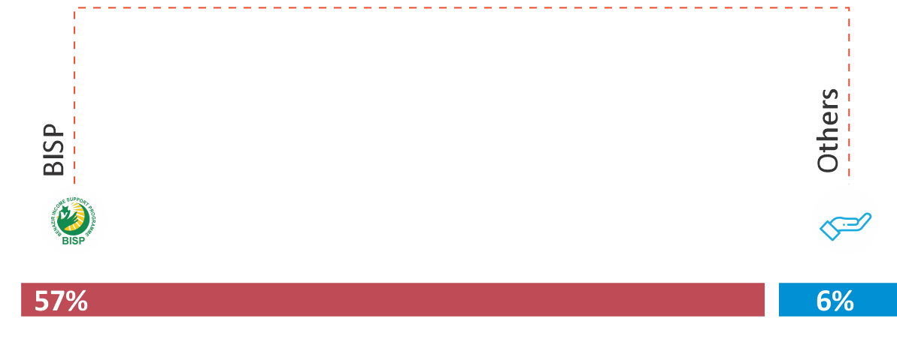
Key Findings
Girls outperform boys in English, with 54% girls able to read at least words, compared to 39% boys.
Overall Learning (5-16): 24%
Overall Learning (5-16): 46%
Overall Learning (5-16): 27%
Can read story
Can read at least sentences
Can read sentence
Can do division (2 digits)
Can read at least words
Can at least so subtraction
Parents with below matric education
Mobile Phones
79%
Smart Phones
46%
Internet Connection
6%
Computers
2%
TVs
100%

Slide 26
Umerkot, Sindh - PS 51
Government School Name | Facilities |  |  |  |  |  | Teacher's Qualification | SMC
 | Playground | Electricity | Library | Clean Drinking Water | Separate Toilets For Girls & Boys | Boundary Wall
GBELS Halo Khan Rahemoon | No | Yes | No | Yes | Yes | No | BA or above = 05 Teachers | Active
GBPS Boder Farm | No | Yes | No | No | No | Yes | BA or above = 02 Teachers Matric = 02 Teachers | Inactive
GBPS M. Salhe Palli (Baboo Faqeer) | No | Yes | No | Yes | No | Yes | BA or above = 02 Teachers | Inactive
GBELS Halo Khan Raheemoon
50% of Grade 5 students could read Urdu story
50% of Grade 5 students could read sentences.
50% of Grade 5 students could do division
Government Boys Primary School in Boder Farm
0% of Grade 5 students could read Urdu story
0% of Grade 5 students could read sentences.
30% of Grade 5 students could do division
GBPS Muhammad Salhe Palli Baboo Faqeer
0% of Grade 5 students could read Urdu story
9% of Grade 5 students could read sentences.
9% of Grade 5 students could do division

Slide 27

Key Findings
Early Years Schooling for ages 3-5:
73% Out of school
81% in government schools
19% in Private School
Enrollment Rate for ages 6-16
6% Out-of-School Children
94% Enrolled in schools
71% in government schools
29% in Private School
Girls OOS = 3% Boys OOS= 3%

Slide 28







Key Findings
Overall Learning (5-16): 55%
Overall Learning (5-16): 40%
Overall Learning (5-16): 54%
Can read story
Can read at least sentences
Can read sentence
Can do division (2 digits)
Can read at least words
Can at least so subtraction
Parents with below matric education
Mobile Phones
98%
Smart Phones
73%
Internet Connection
56%
Computers
13%
TVs
100%

Slide 29
Lower Dir, Khyber Pakhtunkhwa - PK 14
Government School Name | Facilities |  |  |  |  |  | Teacher's Qualification | SMC
 | Playground | Electricity | Library | Clean Drinking Water | Separate Toilets For Girls & Boys | Boundary Wall
GHSS Khall Kandarow | No | Yes | No | Yes | No | Yes | MA or above = 19 Teachers BA = 06 Teachers B.Ed = 19 Teachers M.Ed = 07 Teachers | Active
GMS Razagram Tornang 2 | No | Yes | No | Yes | No | Yes | MA or above = 09 Teachers B.Ed = 03 Teachers M.Ed = 02 Teachers | Active
GPS Sangolai Payeen no 2 | No | Yes | No | Yes | No | Yes | MA or above = 05 Teachers B.Ed = 04 Teachers M.Ed = 04 Teachers | Inactive
GGPS Khail Kandarow
70% of Grade 5 students could read Urdu story.
60% of Grade 5 students could read English sentences.
40% of Grade 5 students could do division.
GPS Shalfalam (Primary Section of GMS)
90% of Grade 5 students could read Urdu story.
90% of Grade 5 students could read English sentences.
90% of Grade 5 students could do division.
GPS Sangolai Payeen Number 2
10% of Grade 5 students could read Urdu story.
70% of Grade 5 students could read English sentences.
20% of Grade 5 students could do division.

Slide 30

Faisal Khan Tarakai
Key Findings
Early Years Schooling for ages 3-5:
96% Out of school
100% in government schools
0% in Private School
Enrollment Rate for ages 6-16
16% Out-of-School Children
84% Enrolled in schools
67% are in government schools
33% in Private School
Girls OOS = 7% Boys OOS= 9%

Slide 31







Key Findings
Overall Learning (5-16): 47%
Overall Learning (5-16): 61%
Overall Learning (5-16): 61%
Can read story
Can read at least sentences
Can read sentence
Can do division (2 digits)
Can read at least words
Can at least so subtraction
Parents with below matric education
Mobile Phones
67%
Smart Phones
49%
Internet Connection
9%
Computers
5%
TVs
100%

Slide 32
Swabi, Khyber Pakhtunkhwa - PK 52
Government School Name | Facilities |  |  |  |  |  | Teacher's Qualification | SMC
 | Playground | Electricity | Library | Clean Drinking Water | Separate Toilets For Girls & Boys | Boundary Wall
GHS Jalbai | Yes | Yes | Yes | Yes | No | Yes | MA or above = 22 Teachers B.Ed = 09 Teachers M.Ed = 15 Teachers | Active
GMS Jalbai | No | Yes | No | Yes | No | Yes | MA or above = 09 Teachers B.Ed = 03 Teachers M.Ed = 06 Teachers | Active
GPS Jalbai Shumali | No | Yes | No | Yes | No | Yes | MA or above = 08 Teachers B.Ed = 02 Teachers M.Ed = 08 Teachers | Active
GPS No. 1 Yarhussain Razar
0% of Grade 5 students could read Urdu story.
50% of Grade 5 students could read English sentences.
10% of Grade 5 students could do division.
GPS No. 2 Yarhussain
9% of Grade 5 students could read Urdu story.
64% of Grade 5 students could read English sentences.
36% of Grade 5 students could do division.
GPS Jalbai Shumali
0% of Grade 5 students could read Urdu story.
0% of Grade 5 students could read English sentences.
0% of Grade 5 students could do division.
GPS No. 1 YarHussain Razar and GPS No. 2 Yar Husain are Nearby Government Primary Schools with Primary Sections

Slide 33
Coverage of Social Protection, Vaccination and Birth Registration
Received the 5 Basic Vaccination
Households in Umerkot followed by Kasur and Kech are protected under BISP

Slide 34

Findings from the FGD:
Perspectives of Parents and Community Members
A parent from Kasur expressed: "We see new school buildings before every election, but inside, nothing changes. Our children still struggle with reading, and there aren’t enough teachers. Who do we even complain to?"
A parent from Kech: “"During campaigns, they talk about ‘education for all,’ but after elections, we are left chasing officials just to get basic repairs done in schools."
Voices from the Community: Key Insights
Low Awareness of Political Roles
Parents and community leaders vote actively but are often unaware of party manifestos or the education responsibilities of elected officials.
Support for Better Teaching Methods
While teachers are respected, parents see a need for improved pedagogy to help children reach their potential to learn-
Gaps Between Promises & Learning Needs
Appreciation for infrastructure investments exists, but there’s a strong call for:
  More teacher training- adequate teachers
  Classroom support
  Focus on early-grade literacy and numeracy

Slide 35
Findings from the FGD:
Perspectives of Middle-Tier Education Officials
Insights from District & Education Officials
Decentralization & Participation
  Officials and community actors express strong interest in greater involvement in decision-making.
  Their learning innovations go unnoticed – ‘always a teacher/pedagogue within us to engage with what works’
  Collaboration with elected representatives varies by constituency- top down more than bottom up
Data Use & Monitoring Gaps
  While data on enrollment, teacher attendance, and infrastructure is collected, learning outcomes are poorly tracked.
Political Disruptions
  Frequent transitions and political competition hamper policy continuity and reform efforts.
Key Requests to Policymakers
  Ensure job stability for education officers to foster positive change and long-term impact
  Allocate resources based on local needs
  Increase teacher inductions to address classroom-student-teacher-ratios (STR)
  Recognize middle-tier officials as critical system actors through monetary/non-monetary incentives

Slide 36
Key Insights
Political Settlement
Enrollment rates range from 78% to 94%.
More boys than girls are out of school in 5 of 8 constituencies
Low ECE enrolment/participation; a low hanging fruit
Few Grade 3 students meet reading or math benchmarks; raise profile of grade 3 as a milestone
Grade 5 shows slight gains, but learning is low.
Children perform better in schools than at home.
Elections driven by personal favors and local deals
Institutions are formal but also highly personalized
Elites are divided and avoid working with non-elite groups
Service delivery relies on personal connections and political party- the party in power vs. constituency
Limited space for lobbying or collective action

Slide 37


Prioritize Learning Outcomes—Not Just Infrastructure:
Link new education initiatives to actual improvements in children’s reading and math skills. Politicians can lead by championing measurable learning targets in their constituency and launching public commitments tied to local school performance.
Acknowledging the Middle Tier:
Recognize the critical role of district and tehsil education officials as frontline reform agents. Strengthen and support this middle tier with resources and decision-making authority to improve education delivery on the ground.
Empower the District Education System:
Collaborate with provincial education departments to create or enhance district-level Education Delivery Cells that regularly monitor school performance, enrolment, and learning outcomes, enabling timely interventions.
Educate Voters on Manifesto Priorities:
Use public forums, media, and constituency communications to raise awareness among voters about your education commitments and progress against manifesto promises. Transparency builds political capital.
Strengthen Birth Registration for Better Education Planning:
Partner with local NADRA offices and health departments to increase birth registration coverage in your constituency. Accurate birth records enable timely school enrolment, age-appropriate grade placement, and targeted education interventions—especially for marginalized children.
Include Education in Your Constituency KPIs:
Make education part of your political report card. Add goals like reducing the number of out-of-school children, improving learning scores, or increasing girls' school attendance—and share progress publicly.
Leverage BISP and Social Protection for School Access:
Work with federal and provincial agencies to align BISP and other social protection schemes with education goals. Ensure that eligible families in your constituency are enrolled and that stipends are linked to school attendance, especially for girls and out-of-school children in extreme poverty.

Slide 38


Slide 39


Slide 40




Thank You

